Slide 1
Amazeing Reality
Mehmet Gül, Johann Bernhardt
04.11.2019
Kickoff: AR Lab Corse WS 2019/2020

Slide 2
Introduction / Motivation
We want to fuse data gathered from GPS, a IMU, a Compass, the camera and maybe more sensors to create an accurate representation of where someone is in the World.
We are then going to use that data to project a Maze into the World through which the user can then go through.
To assist the user, there is going to be an assist feature which will lay down a path showing the shortest path to the exit.
The maze will also show through which paths the player has already passed through to make the exploration easier.

Slide 3
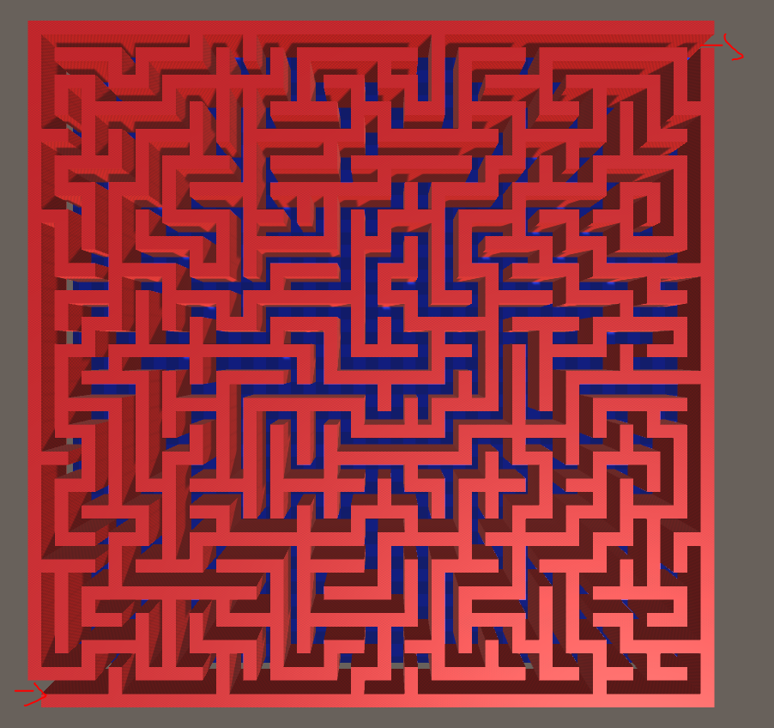
Introduction / Motivation

Slide 4
Potential Issues
Sensor fusion can be complicated!
Not sure what kind of hardware to use.
Not sure how to connect hardware to already existing software.
We might run out of time towards the end.
What if the user tries to run through a wall in the Maze?
What if there are accuracy issues and everything just jitters all the time?
Should we use a game engine like Unity?

Slide 5
Features
Must haves:
  Sensor fusion of GPS and camera
  Projection of the maze at the right place
Nice to haves:
  More sensors for even better accuracy
  Better looking maze
  A maze solver to show the user the path to the exit
  Ways to interact with the maze (a monster hunting the user, bombs to blow up walls)
  Special effects

Slide 6
Teamwork
Johann already has some experience in this Area, which will make the sensor fusion a little bit easier
Mehmet already has some experience in Unity and has already worked with mazes and procedural generation before
But of course everyone is going to participate in all aspects of this project to learn the most about Augmented Reality applications

Slide 7
Time Line
First milestone: (2 Weeks)
  Get the sensors up and running
Second milestone(2 Weeks)
  Implement the sensor fusion
Third milestone: (1-2 Weeks)
  Get the information into Unity
  Maze placed accurately in the world
  User can walk through the maze without any issues
Fourth milestone (2 Weeks):
  Improve the accuracy as much as possible
  Add special effects

Slide 8
List of References
…
…

