Slide 1
360 Tetris:
Using gamification to collect training data
Md Jamiur Rahman, Patrick Radner, Ahnaf Munir
September 12, 2019
Final: Master Practical: Games Engineering
Director: Prof. Gudrun Klinker (Ph.D.)
Supervisor: Adnane Jadid

Slide 2
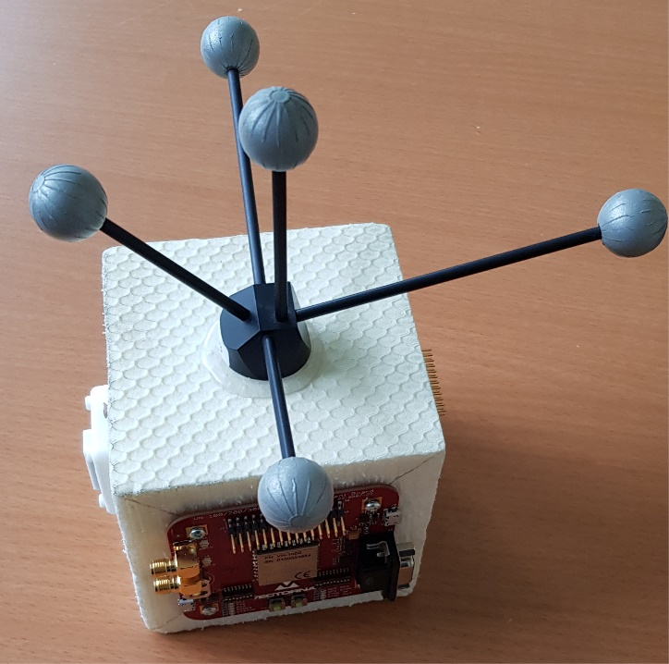
Introduction
Motion data collection for neural network training
Outside-In System
➔ ART (Advanced Realtime Tracking)
  Consists of cameras and a target
  3 DoF Translation
  3 DoF Rotation

Slide 3
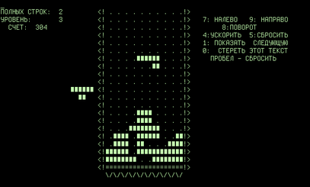
Problem Description: Issues
Data collection is boring ☹
➔ Gamification
  Tetris
  Created in 1984
  Very popular
  Easy to play

Slide 4
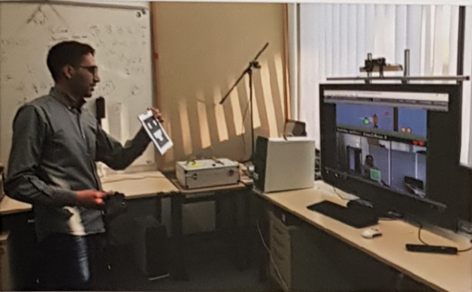

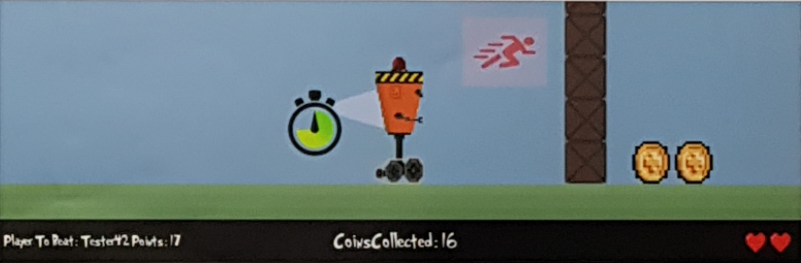
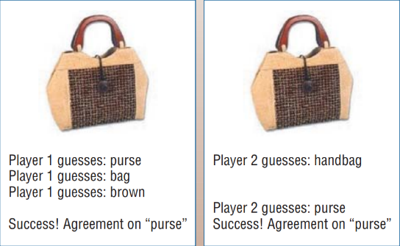
Existing Solutions
Gamifying Stereo Camera Registration for Augmented Reality
Games with a Purpose

Slide 5
Goals of this Practical
Collect data
  Make the data collection interactive
  Engage player for longer period of time (=more data)
Ensure 6DoF
  Interaction Design

Slide 6
Proposed Work
Standard Tetris
Tetris walls surrounding the player
Virtual Reality
3 degree of Rotation
3 degree of Translation

Slide 7
Discussion of Potential Issues
ART target can be occluded by player
Limited real-world space
Wires
Cybersickness
Obstacles in real world

Slide 8
Implementation
Game
  Audio
  Visual Effects
  3D Asset Modeling
  Game Logic
  Extend game modes
Interaction
  Keyboard and Mouse
  HTC HMD
  HTC Controller
  ART Target
Code Improvement
  Bug Fixing
  Testing
3D asset modeling
Game logic
Audio
Basic Visual Effects
Interaction with keyboard and mouse
Integration with HTC Vive
Implementation of different effects
HTC Vive controller integration
ART Integration
Efficient collection of tracking data
Extend game modes
Bug Fixing
Testing

Slide 9
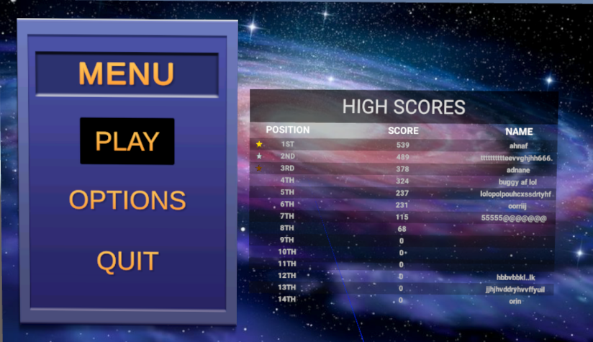
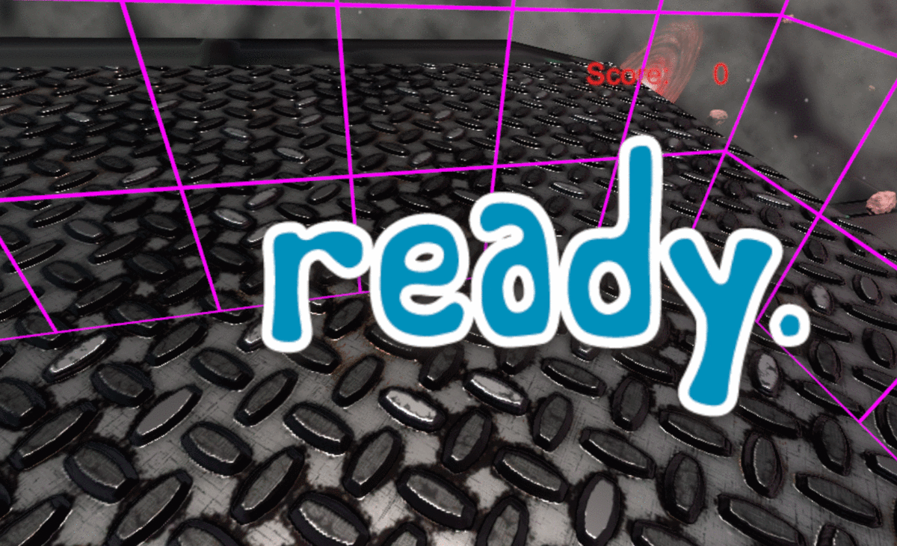
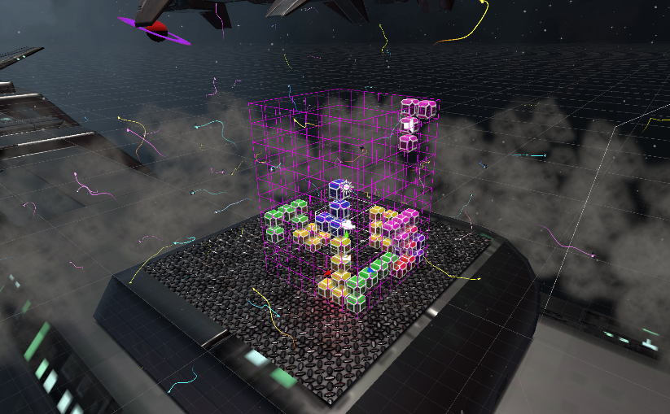
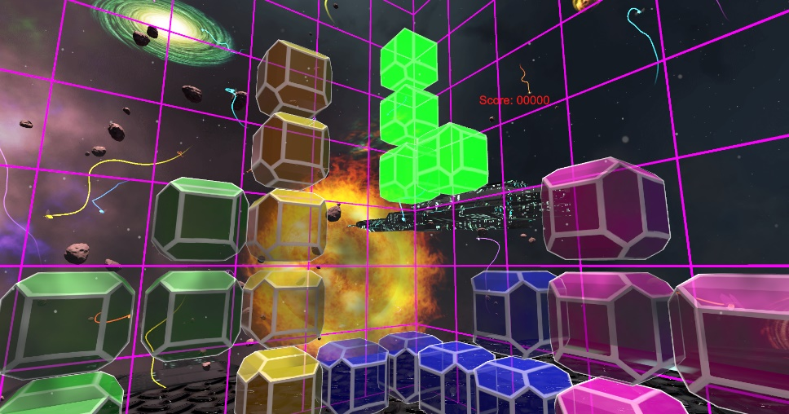
Implementation

Slide 10
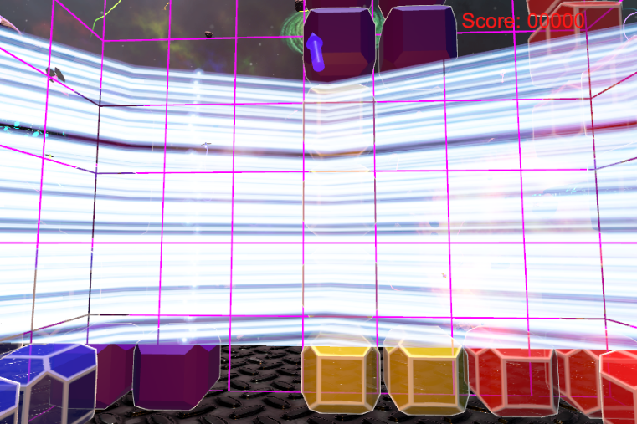
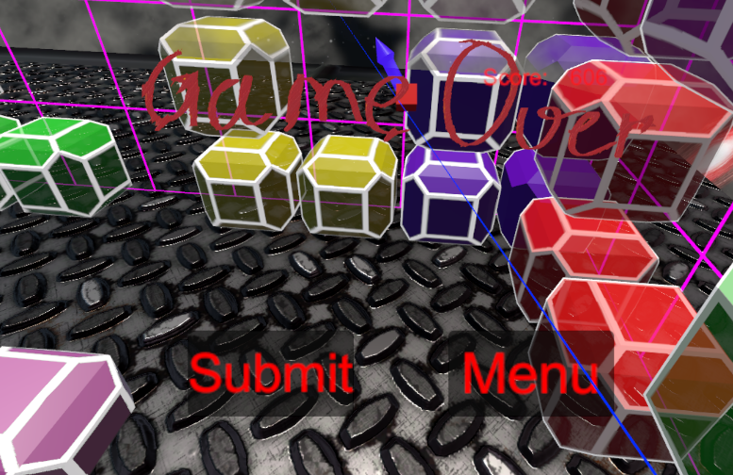
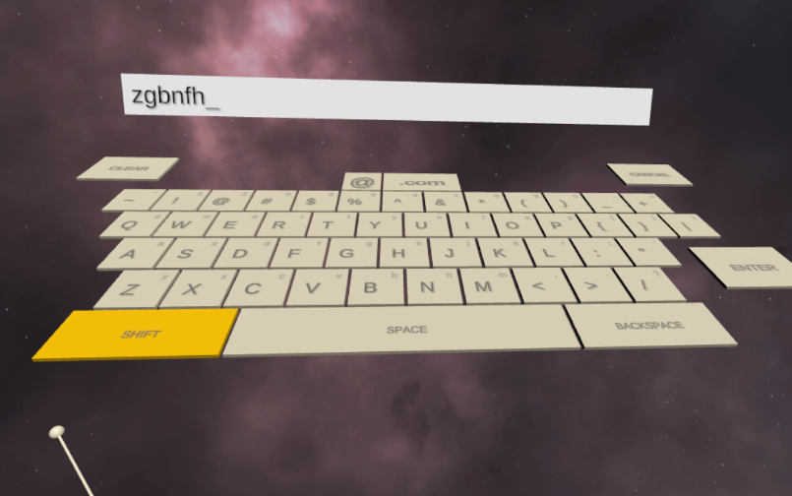
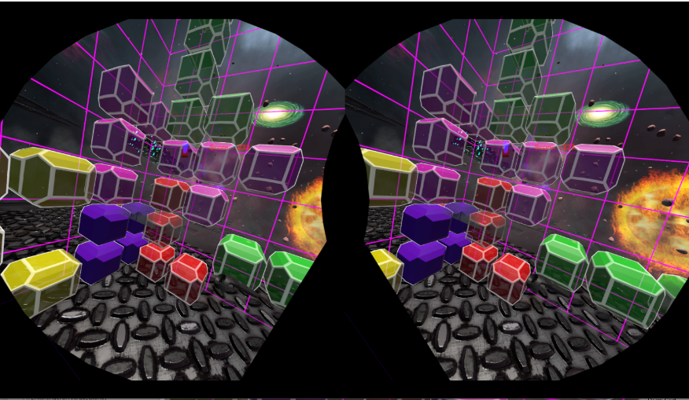
Implementation

Slide 11
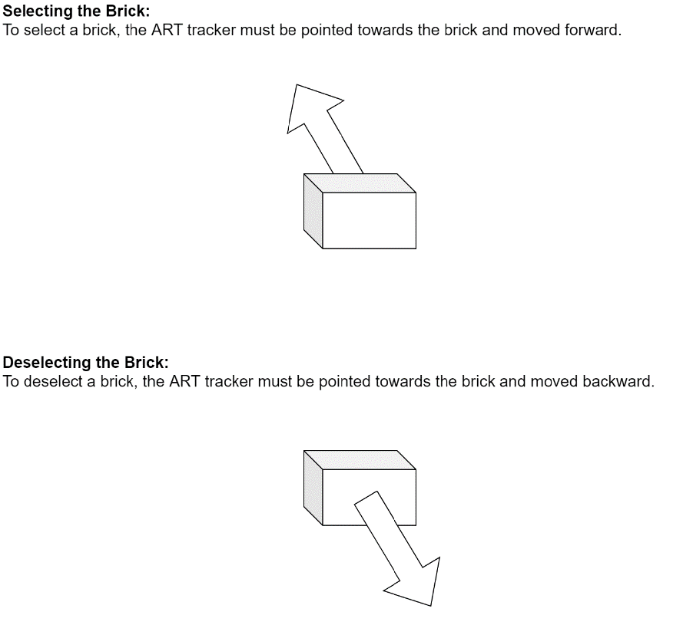
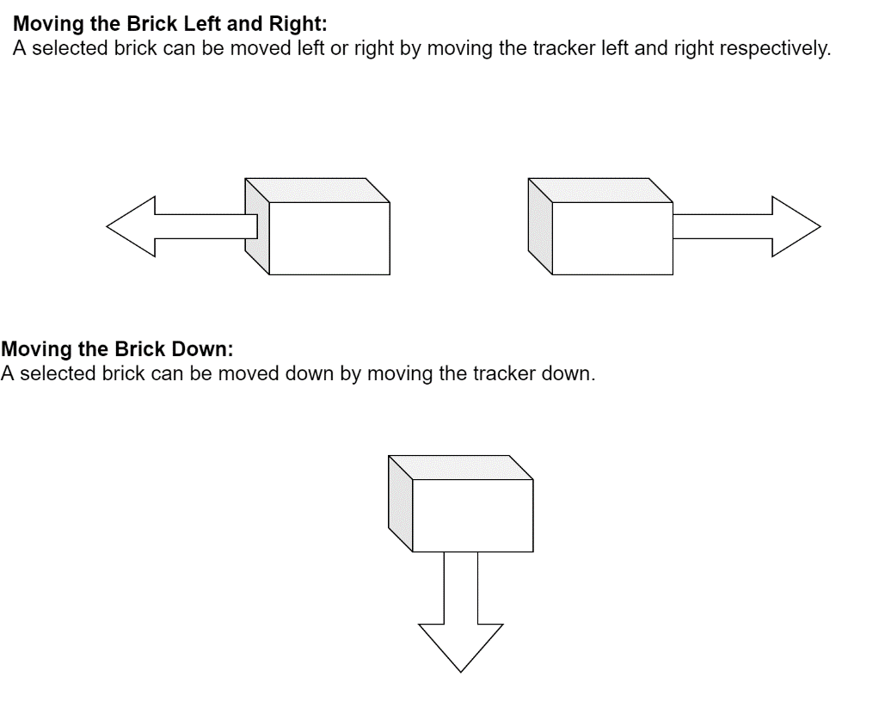
Interaction Design

Slide 12
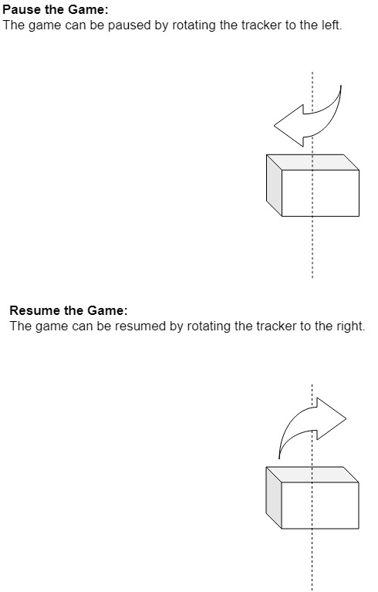
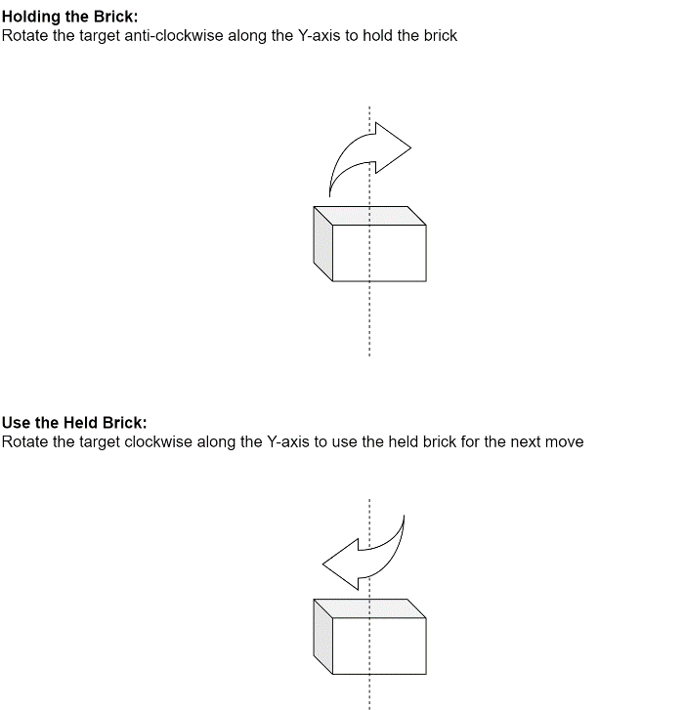
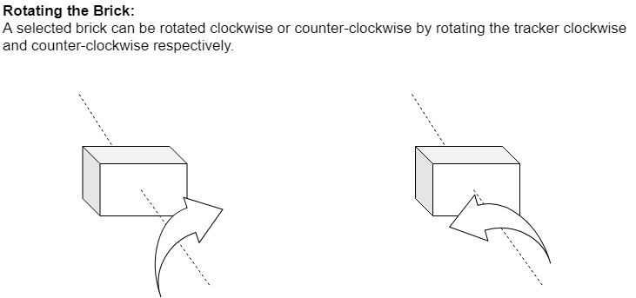
Interaction Design

Slide 13
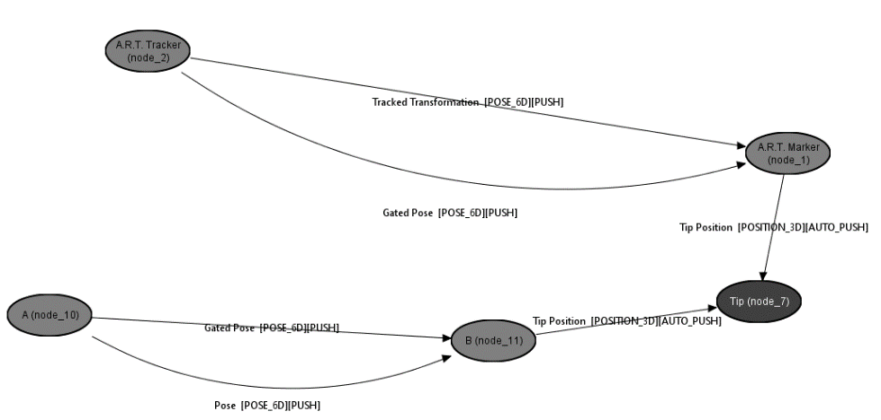
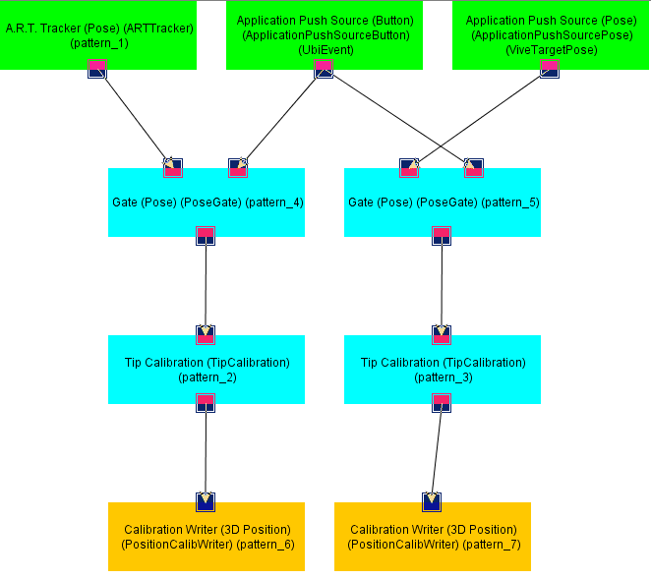
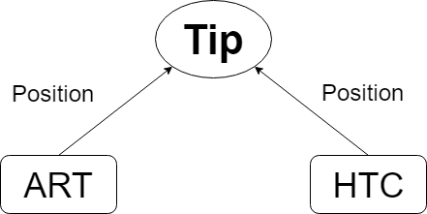
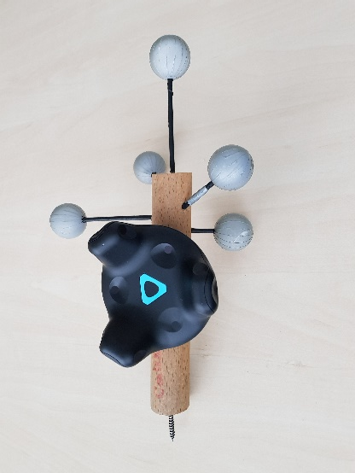
Tip Calibration

Slide 14
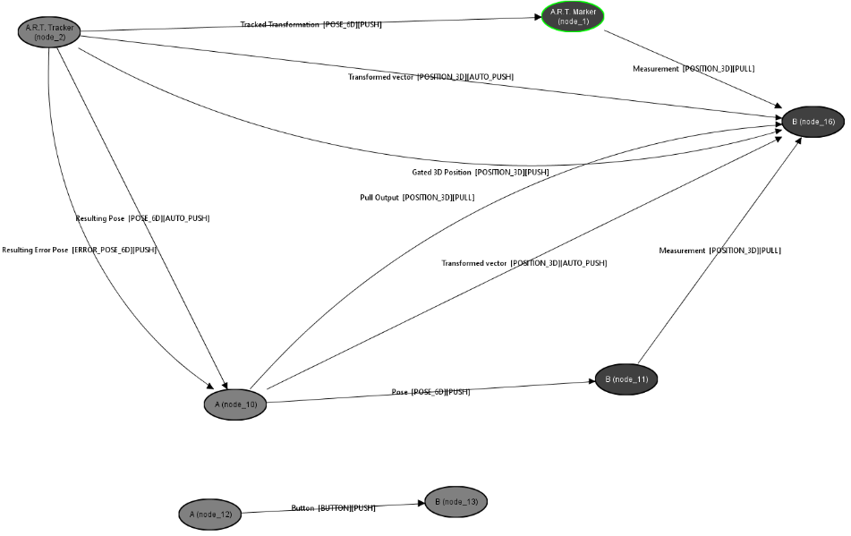
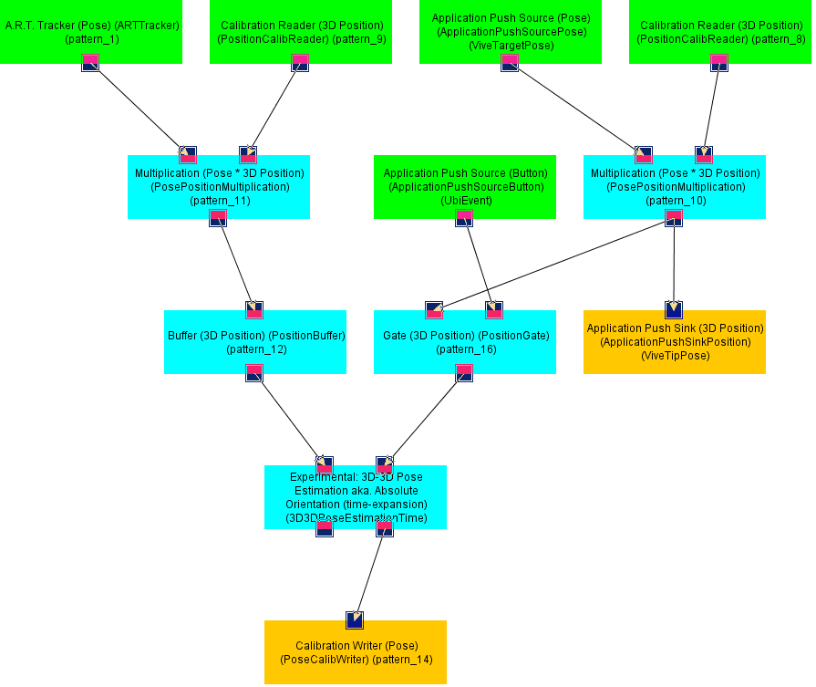
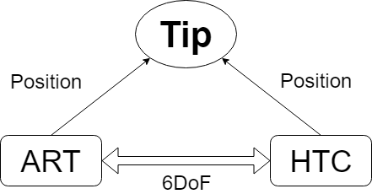
ART to HTC Transformation

Slide 15
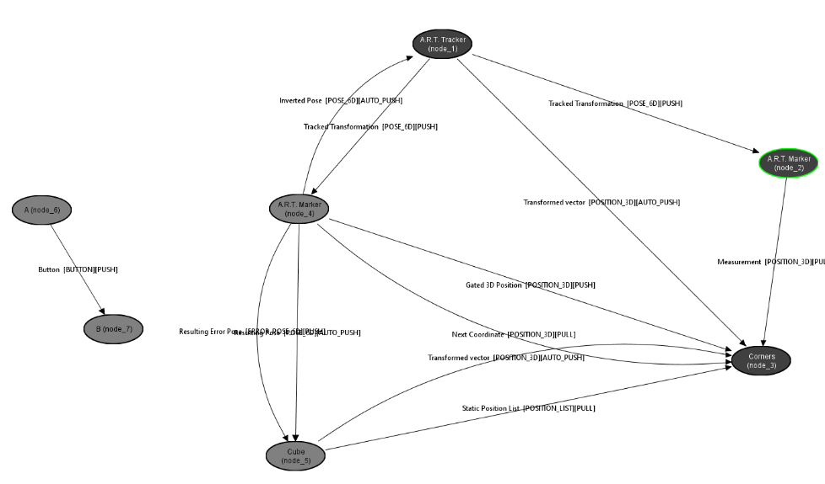
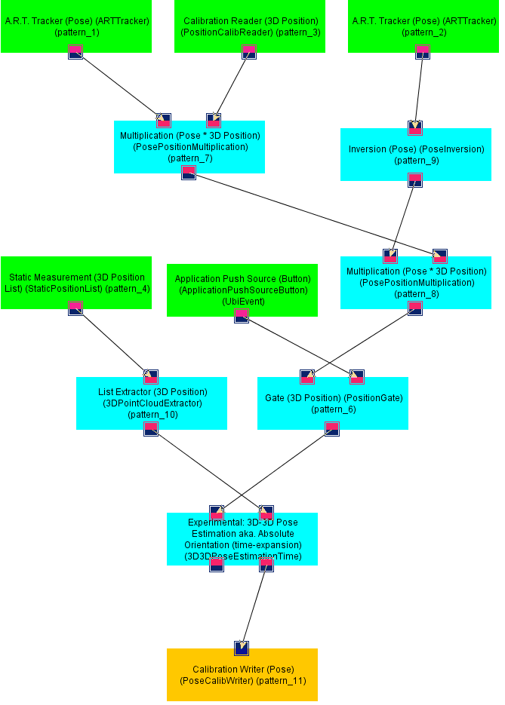
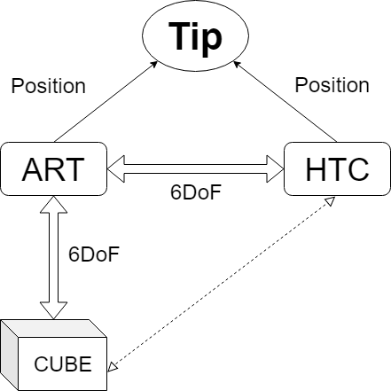
Cube to ART Transformation

Slide 16
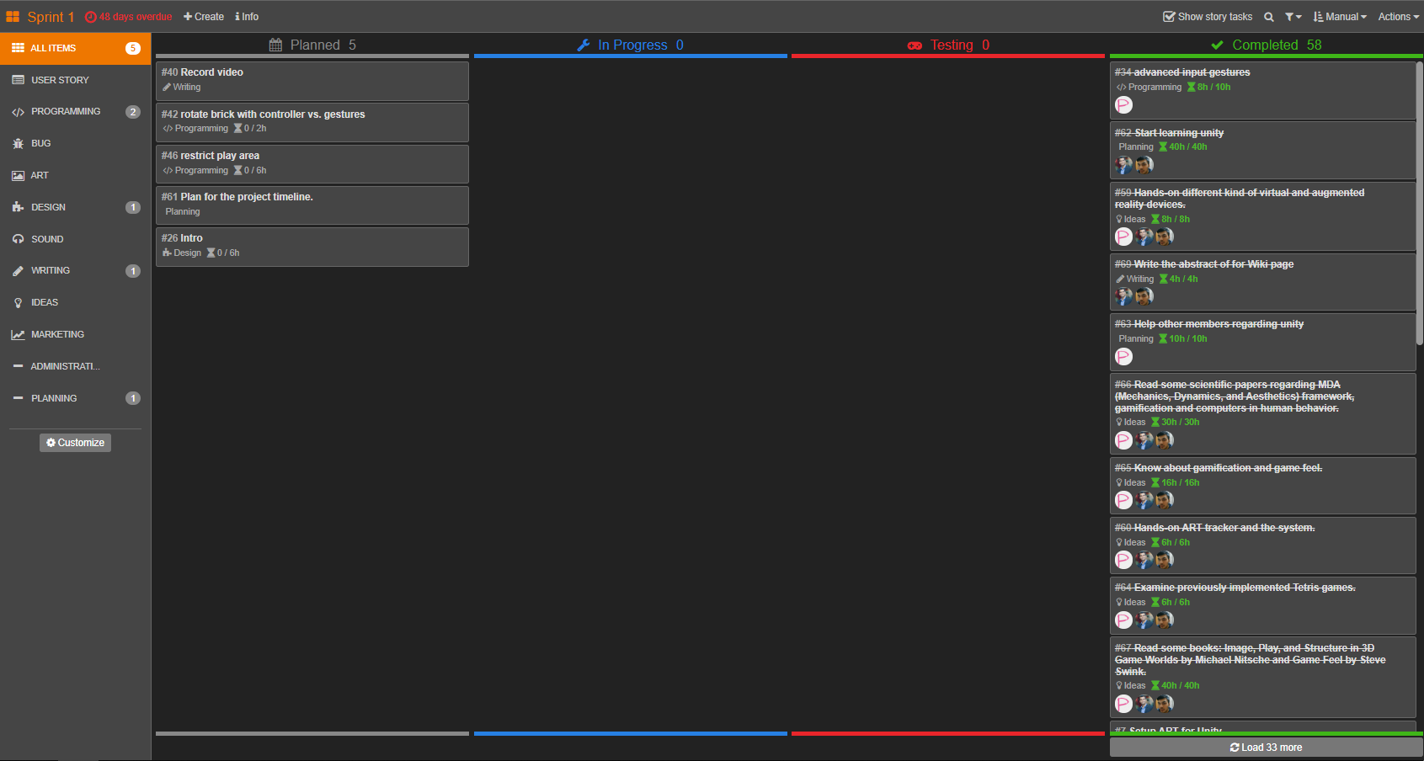
Project Management

Slide 17

Project Management

Slide 18
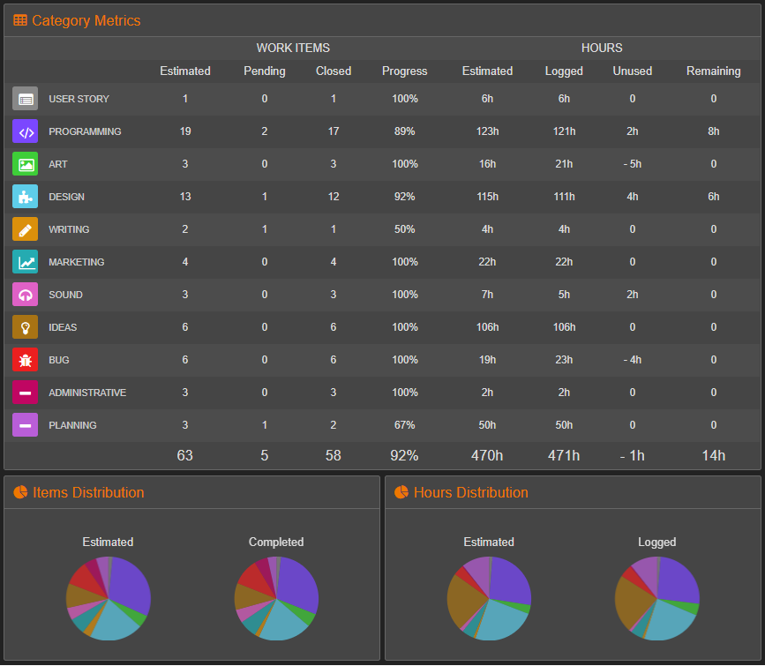
Project Management

Slide 19
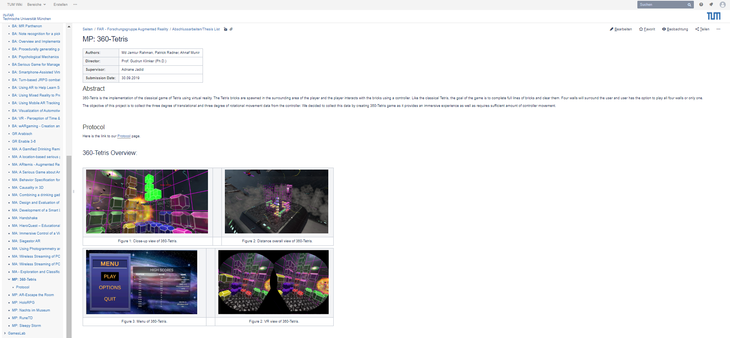
Our Main Webpage

Slide 20

Our Protocol Page

Slide 21
Evaluation (Test Runs in Demo Day)
It's very fun, the controls are very intuitive. It's not something you get to do every day. My only complaint is that sometimes the grab function didn't work as intended.
The game is very fun; it gets a bit glitchy sometimes in selection, but I don't know if that's normal in VR games. It did not affect my experience much anyway. Gear Job! 4 / 5.
Cool idea, but rotating the cubes is too sensitive. When positioning them down they rotate sometimes too. Good thing is also, I didn't get dizzy (Lächeln)
Game cuts out. Pieces more involuntary, putting pieces on the ground should be managed by a button.
Zu ruckavtigess bewegen der Bläcke.
Though a while until I realized that there is a cursor in the center of the view positions. I tried to push the blocks to select them without specifically pointing towards them.
Track rotation 2 controllers vs gesture.
Got motion with the tracking of the Vive. So I had problems when trying to involve with the blocks (grabbing the pieces etc.) I think the way the structure behaves when it's in a corner (it adjust to it)
This seems really cool. One simple comment regarding the tracking, it can be made more robust.
First, I did not understand the game, but it's the same which I need to play in my childhood and its really cool. Tracking can be improved.
It took a little moment to understand the interaction (pushing, rotating), but then it was great fun.

Slide 22
Future Work
Menu with Control Cube
Different Themes
In-game currency / shop
Online Highscore
Scale game based on user height

Slide 23
Conclusion
360 Tetris
  HTC Vive
  ART
Fun way to collect training data

Slide 24
Demo

Slide 25
List of References
Langbein et al. Gamifying Stereo Camera Registration for Augmented Reality. ISMAR, 2018
Swink, Steve. Game Feel: A Game Designer's Guide to Virtual Sensation. Routledge, 2008.
Luis von Ahn. Games with a Purpose. IEEE Computer Society Press Los Alamitos, 2006.
Seymour et al. Virtual reality training improves operating room performance: Results of a randomized, double-blinded study. Annals of surgery, 2002.

Slide 26
Thank You
☺

