Slide 1
Plants Vs Insects
Jana Hoffard, Anastasia Pomelova
04.11.19
Kickoff: AR Lab Course WS 2019

Slide 2
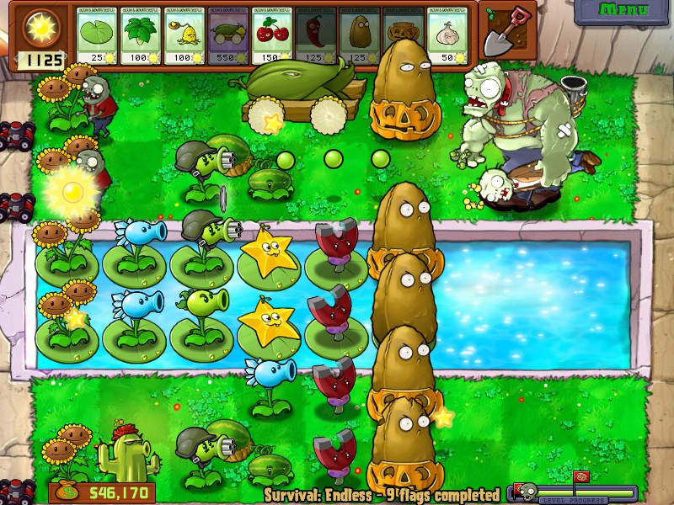
Introduction / Motivation

Slide 3
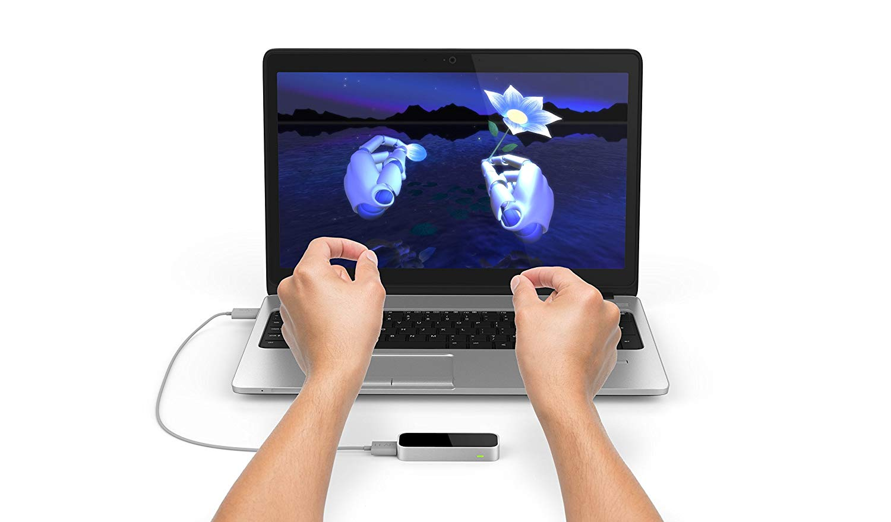
Introduction / Motivation

Slide 4
Potential Issues
Gestures
  Game mechanics: find useful gestures
  Best placement of LeapMotion
  Implement additional gestures
Balancing
  Can’t build full scope of original game

Slide 5
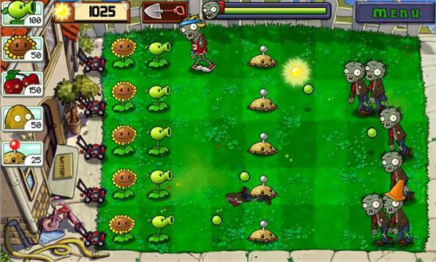
Features
Must haves
  Gesture Input
  3 plant & 2 enemy types
  Environment & selection
  Gameplay
    Spawn enemies
    in waves
    (Re-) place plants
    Currency system

Slide 6
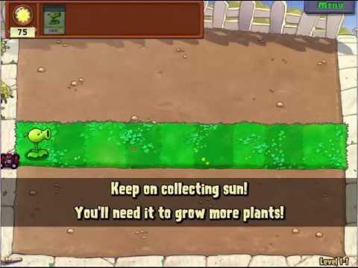
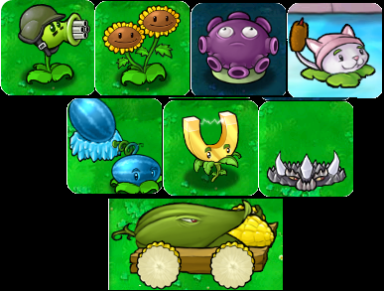
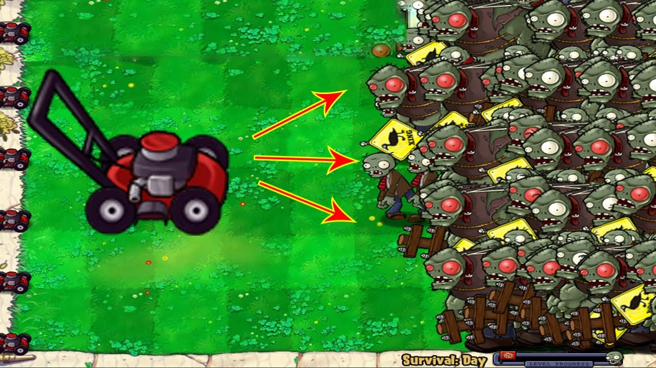
Features
Should haves
  Tutorial
  Upgrade plants
  Small mechanics
    lawn mover

Slide 7
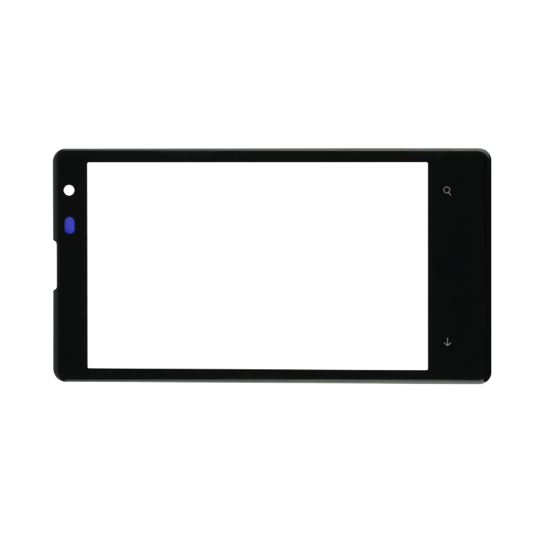

Nice to haves
  Asynchronous gameplay
  Vive integration
  More plant
  and enemy types

Slide 8
Teamwork
Jana:
  Gesture input
  Enemies
  Gameplay loop
Anastasia:
  Gesture input
  Plants
  Environment & selection

Slide 9
Time Line
In 2 weeks:
  Set up leap and decide on the gestures
In 4 weeks:
  All gestures work
  Chessboard environment & place plants
In 6 weeks:
  Basic gameplay
  Placeholder graphics

Slide 10
Time Line
In 8 weeks:
  Graphic, animation, effects
  Should haves
In 10 weeks:
  Polishing
  Bugfixing
  Nice to haves

Slide 11
List of References
https://steamcommunity.com/sharedfiles/filedetails/?id=1471115599
https://www.amazon.in/Leap-Motion-Controller-Packaging-Software/dp/B00HVYBWQO
https://windows.appstorm.net/roundups/the-very-best-of-windows-phone-gaming/
https://walls360.com/plants-vs-zombies-ii-imp-mermaid-zombie/
https://i.ytimg.com/vi/TLWuCaeBxKI/hqdefault
https://vignette.wikia.nocookie.net/plantsvszombies/images/c/c1/The_Eight_Upgrade_Plants.png/revision/latest?cb=20110112020057
https://i.ytimg.com/vi/9B5ODO8_ezU/maxresdefault.jpg

