Slide 1
A Gamified Drinking Reminder Application for Seniors
Matthias-Neal Wadlinger-Köhler
16.5.2019
Final: Master Informatics
Supervisor(s): Christian Eichhorn, Daniel A. Plecher

Slide 2
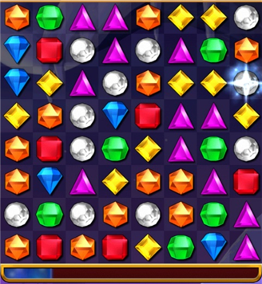
Introduction
Tablet-Based Serious Game as Health Intervention
  Aging population => increased need for health interventions
  Tablets are a promising medium for digital interventions because of: ubiquitousness, affordability, intuitive controls
  Games make the health intervention enjoyable and can have additional benefits
Health Intervention: Drink Reminder
  Optional use of a drink Gadget
  Dehydration becomes greater risk for seniors[1]
Chosen Game: Matching Puzzle
(i.e. Bejeweled/Candy Crush)

Slide 3
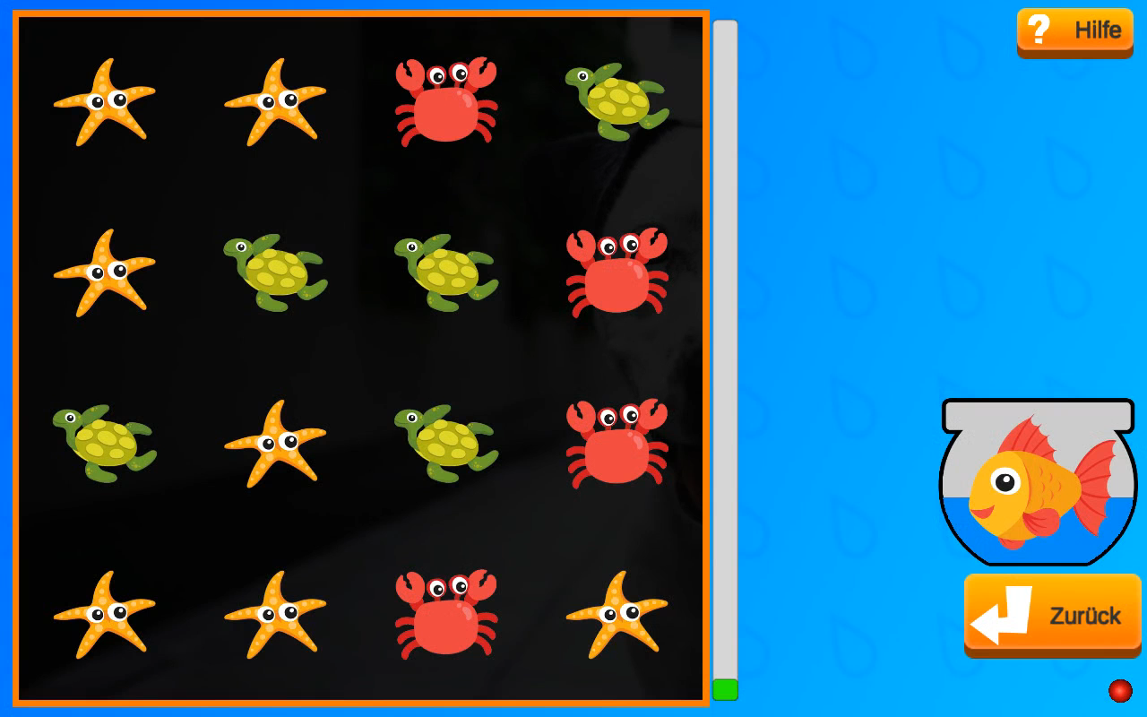
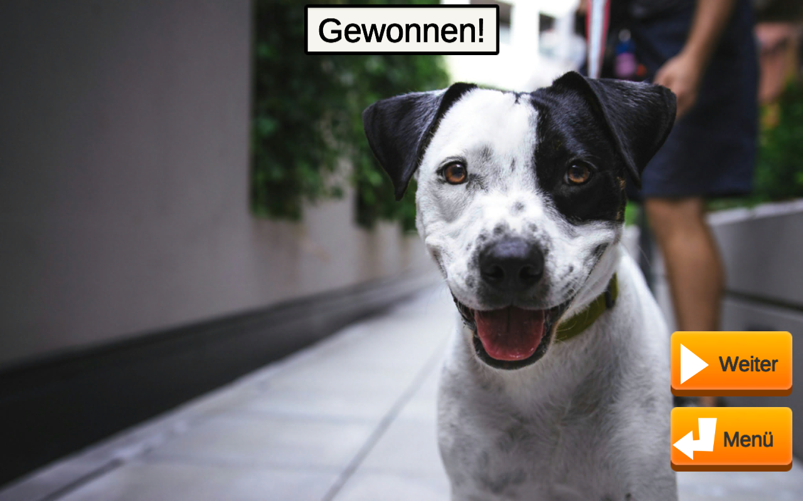
Introduction
Matching Puzzle
  Simple, repeatable gameplay
  Popular with older demographic[8]
Added Gameplay Incentive:
Reveal Background Image
Customization
  Use of familiar images to personalize experience
  “Interactive Photobook”

Slide 4
Goals of this Thesis
Adaptation of a modern Game Concept
  Are seniors open to learning new games?
  How can the game be simplified and how much simplification is necessary?
Use of Familiar Imagery
  In what ways can the game be personalized?
  What are the effects of a personalized experience?

Slide 5
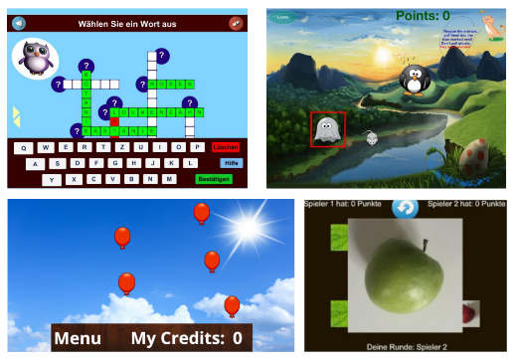
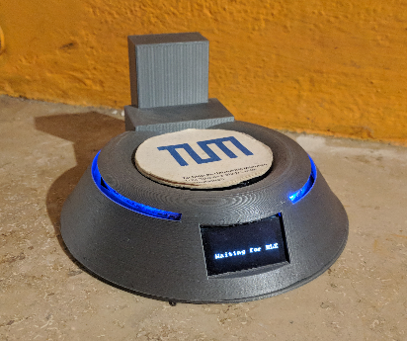
Related Work: Project Enable 3-6
Previously Developed Serious Games[2]
  Memory, Crosswords, etc
Bluetooth Drinking Gadget[3]
  Measures the liquid volume of drinking cups placed on it
Combination of Serious Games and Gadget
  Application that logs the amount of liquid drunk while playing

Slide 6
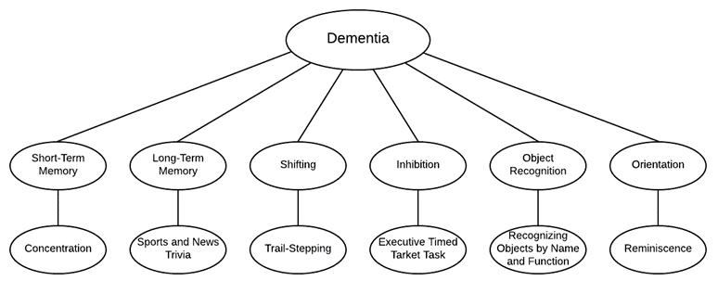
Related Work
Research into Age Related Health Issues
  Cognitive decline (dementia, memory problems)[4]
  Visual impairments (cataracts, color vision)[5]
  => Creation of guidelines for developing senior-targeted
  applications
Research into Cognitive Stimulation of Specific Game Genres [6,7]
  Use of imagery can train object
  recognition and orientation
  Matching Puzzle stimulates
  short-term-memory-, attention-,
  problem-solving-skills

Slide 7
Implementation Overview
Implemented with Unity
  Many benefits for app/game-development
  Ensures compatability with previous and future projects of Enable
Senior Friendly UI Design
Adapted Gameplay
Game Customization and Personalisation

Slide 8
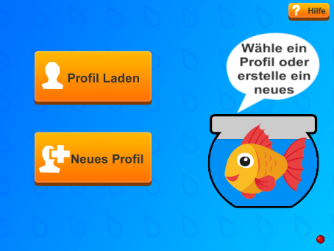
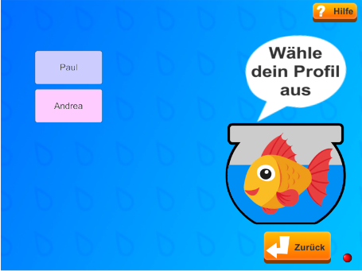
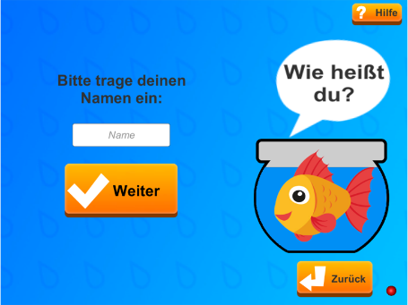
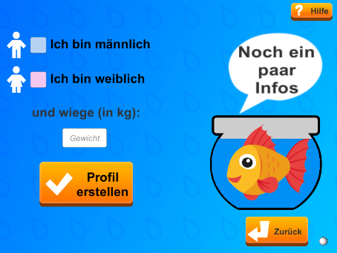
Implementation:
User Interface Design
Consistent User Interface Design
  Same theme/designs used across all menus
  Works with different screen resolutions
User Profiles
  Used to store individual drinking data and user settings
“Water”-Theme
  Colors, Imagery, Companion, Gameplay

Slide 9
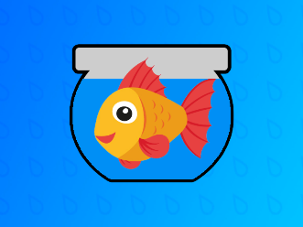
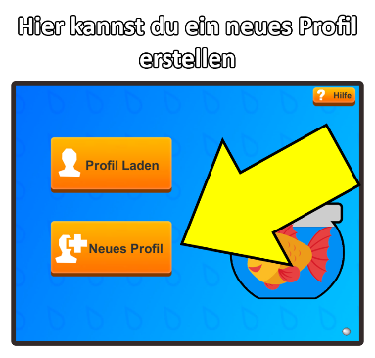
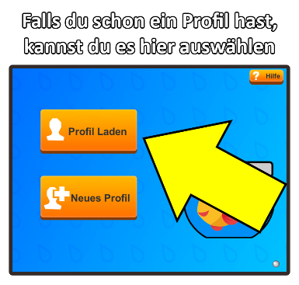
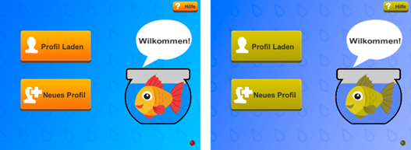
Implementation:
User Interface Design
Companion
  Gives hints and acts as “drink countdown”
Tutorials
  Explain gameplay and each UI element on every menu screen
  Can be accessed any time
General UI Features
  Large text- and UI-size
  Symbols in addition to text
  Use of contrasting colors to ensure colorblind-friendliness

Slide 10
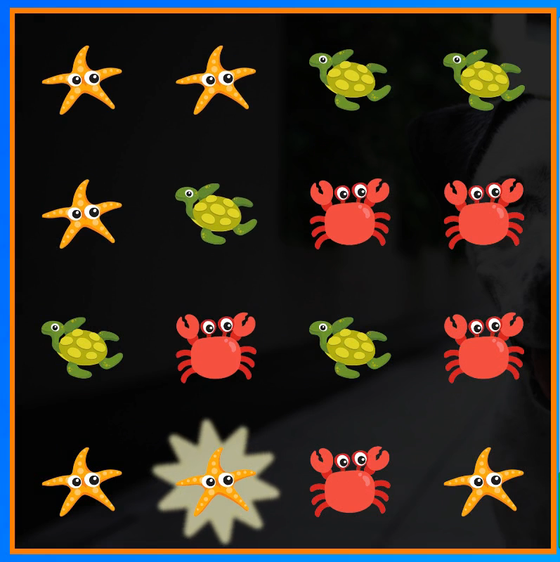
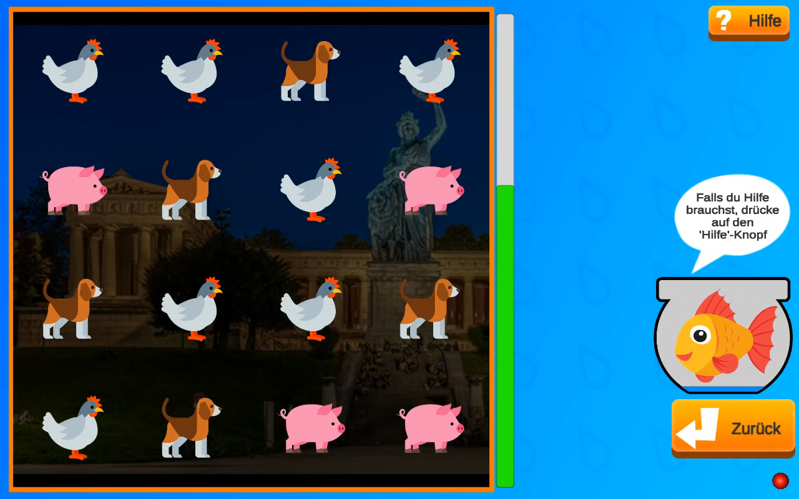
Implementation:
Gameplay
Matching Puzzle Gameplay
  One type of bonus object
  Hint function that shows possible matches, makes “Autopilot” possible
Drink Reminder Interaction
  Water balloon is rewarded after drinking

Slide 11
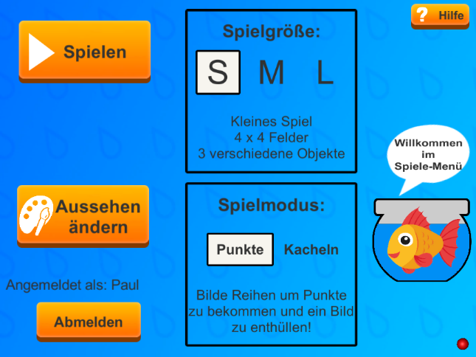
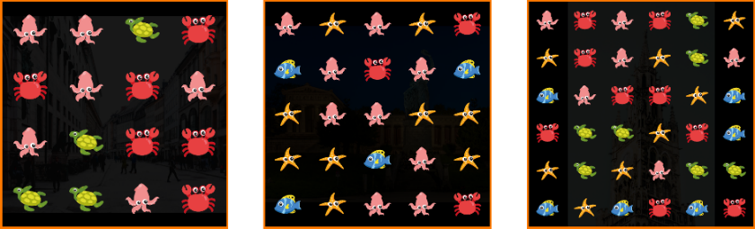
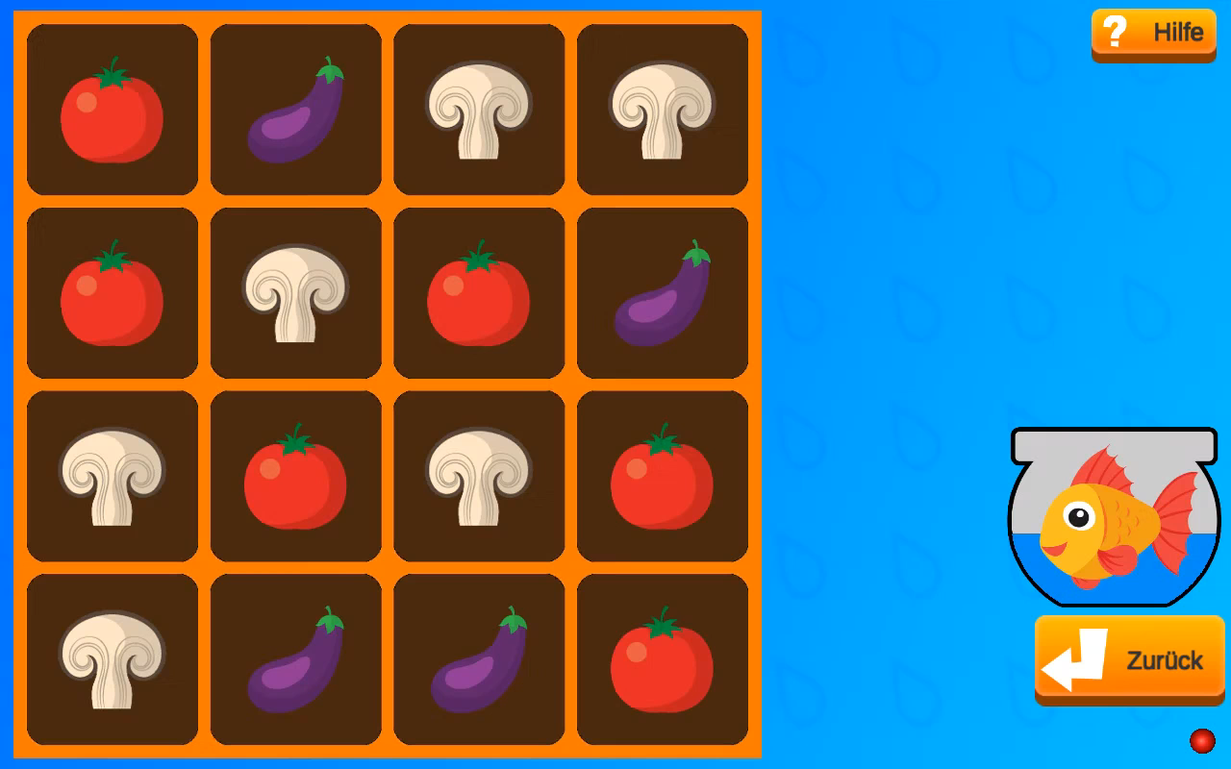
Implementation:
Gameplay Settings
Adjustable Game Size
  Small, medium and large
  Increasing size increases difficulty
  Difficulty settings are important because of differing cognitive abilities
Second Game Mode: Tiles
  Remove tiles to reveal the image
  More challenging than Points-Mode

Slide 12
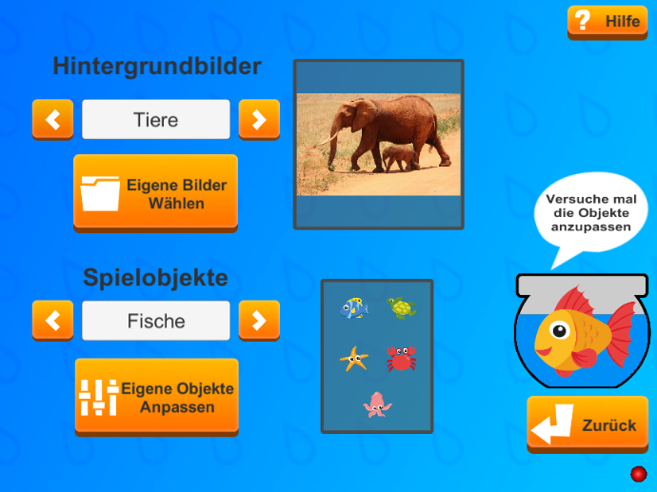

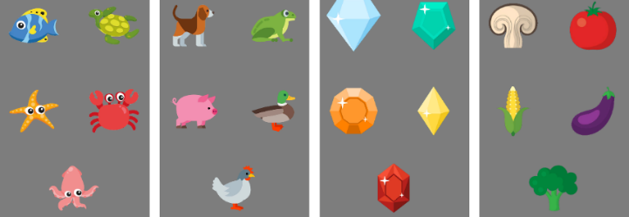
Implementation:
Visual Customization
Multiple available Themes for Background Images and Game Objects
  Background themes include pictures of nature and popular cities
  Game object themes contain different visually distinct icons
Custom Background Images
  Import any number of Images stored on the device to use in the game
  “Interactive Photobook”

Slide 13
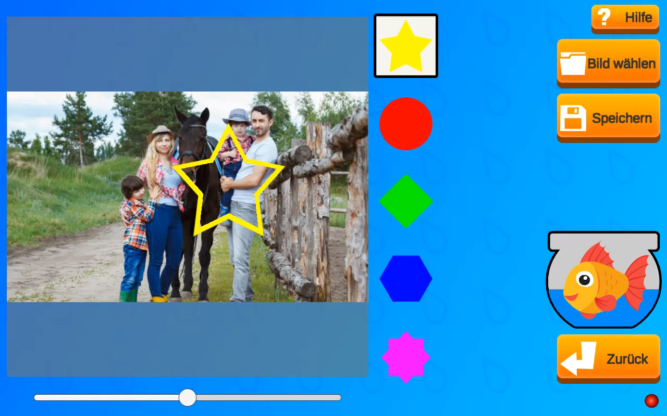
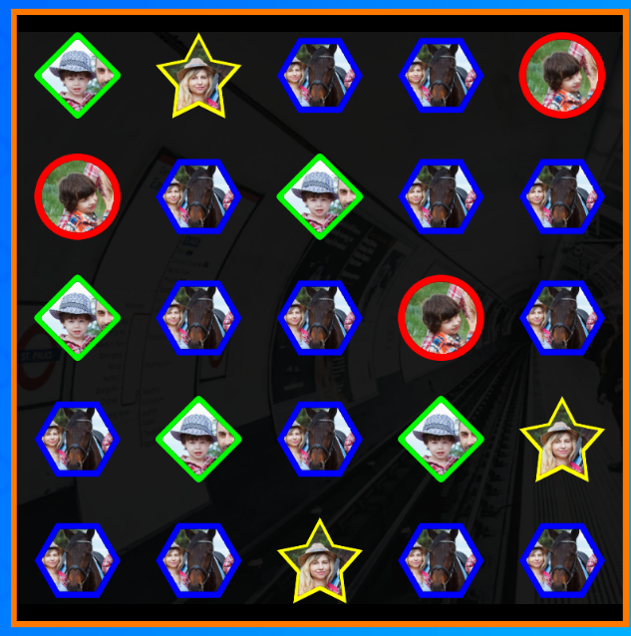
Implementation:
Visual Customization
Custom Game Objects
  Create custom game objects using familiar images
  Custom images are saved for each user

Slide 14
Evaluation / Test Run
Small Scale Test Run at a Nursing Home
  Interview with nursing home supervisor
  8 residents, all suffering from different stages of dementia, were approached, 5 actively participated
Findings:
  All Participants had issues understanding the game and needed minor to major assistance
  However, all that tried playing had an enjoyable experience
  Participants were able to identify the imagery
  Testing of customization was limited, but triggered a positive response

Slide 15
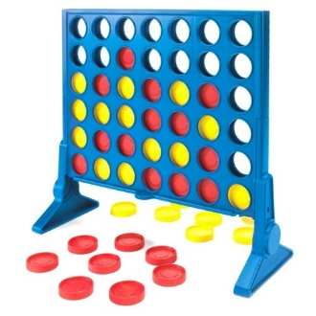
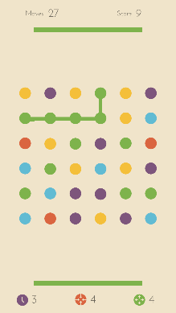
Discussion / Suggested Future Work
Possible Improvements:
  UI Improvements
  Simpler game mode
  Option to disable certain features
  Voiced/Video tutorials
Ideas for Future Work:
  Utilization of customization feature in more familiar games
  Adaptation of other modern games

Slide 16
Conclusion
Adaptation of a modern Game Concept
  Most seniors were open to trying to learn a new game and found the experience enjoyable
  Playing the game was more difficult for them than expected, more time to learn and/or simplifications necessary
Use of Familiar Imagery
  Succesful implementation of image customization within Unity
  Positive first responses to use of familar imagery, but more testing necessary

Slide 17
List of References
Mentes, J. (2006). ORAL HYDRATION IN OLDER ADULTS. AJN, American Journal of Nursing, 106(6), 13–22.
Eichhorn, C., Plecher, D. A., & Klinker, G. (n.d.). Innovative game concepts for Alzheimer patients.
Eichhorn, C., Plecher, D. A., Lurz, M., Leipold, N., & Markus, B. (n.d.). THe Innovative Reminder in Senior-focused Technology ( THIRST ) – Evaluation of Serious Games and Gadgets for Alzheimer Patients, 1–20.
T. Hedden and J. D. Gabrieli. Insights into the ageing mind: A view from cognitiveneuroscience. 2004.
S. M. Salvi and S. Akhtar. “Ageing changes in the eye.” In: Postgrad Med J 82 (2006)
A. Vasconcelos, P. A. Silva, J. Caseiro, F. Nunes, and L. F. Teixeira. “Designing tablet-based games for seniors.” In: Proceedings of the 4th International Conference on Fun and Games - FnG ’12 April 2014 (2012), pp. 1–10.
T. Tong, J. H. Chan, and M. Chignell. “Serious Games for Dementia.” In: Proceedings of the 26th International Conference on World Wide Web Companion – WWW ’17 Companion (2017), pp. 1111–1115.
M. Mason. Demographic Breakdown of Mobile Gamers | MagmicMagmic. url: http://developers.magmic.com/demographic-breakdown-casual-mid-core-hard-core-mobile-gamers/ (visited on 03/16/2019).

