Slide 1
Oppidum
Andrea Müller, Katharina Sadzik, Michael Schlicker
22.10.2020
Final: Master Practical Course
Supervisor(s): David Plecher

Slide 2
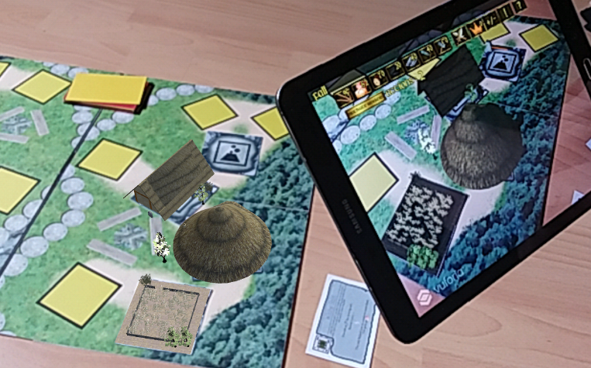
Introduction
Turn-Based Hybrid AR Board and Serious Game

Slide 3
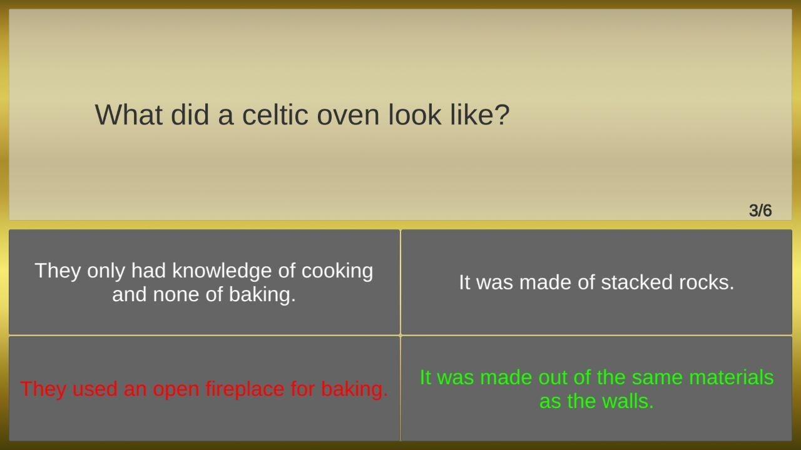
Introduction
Oppidum as Cultural Heritage [1]
Cultural Awareness
Historical Reconstruction
Heritage Awareness

Slide 4
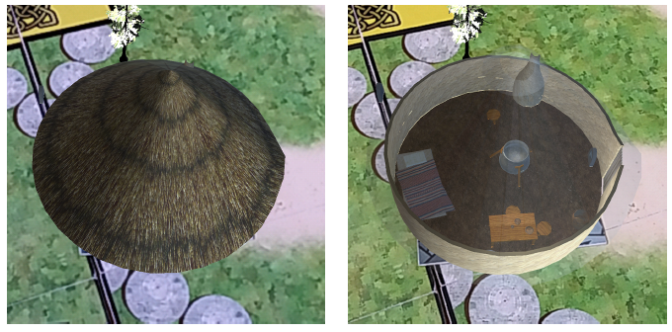
Introduction
Oppidum as Cultural Heritage [1]
Cultural Awareness
Historical Reconstruction
Heritage Awareness

Slide 5
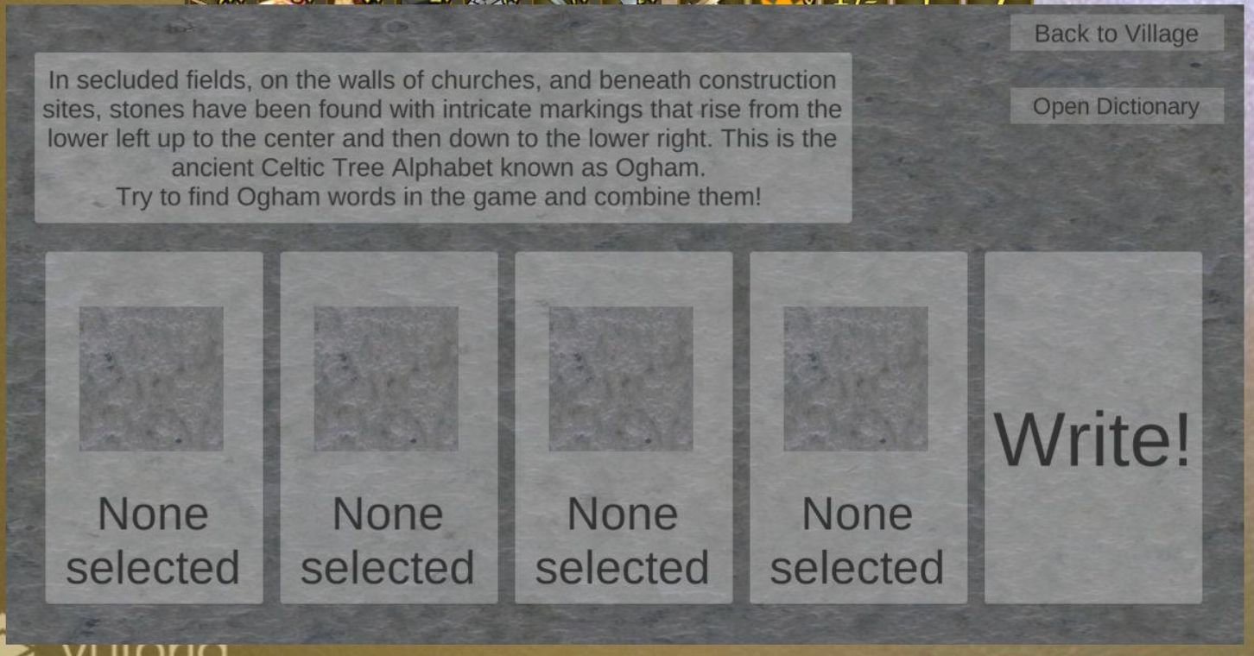
Introduction
Oppidum as Cultural Heritage [1]
Cultural Awareness
Historical Reconstruction
Heritage Awareness

Slide 6

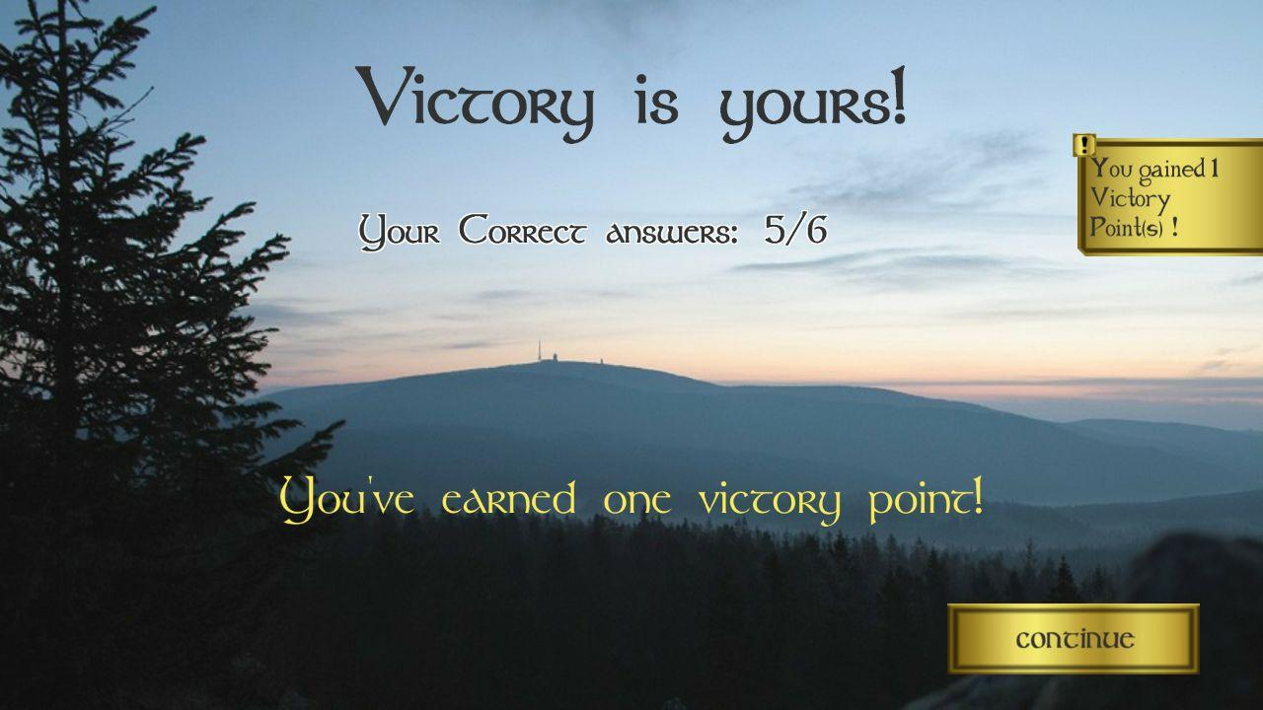
Introduction - Serious Games
Combination of Entertainment & Serious Content
Competition: Knowledge for the Victory!
Keeping Players busy
AR features

Slide 7
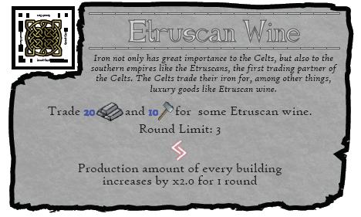
Introduction - Serious Games
Combination of Entertainment & Serious Content
Competition: Knowledge for the Victory!
Keeping Players busy
AR features

Slide 8
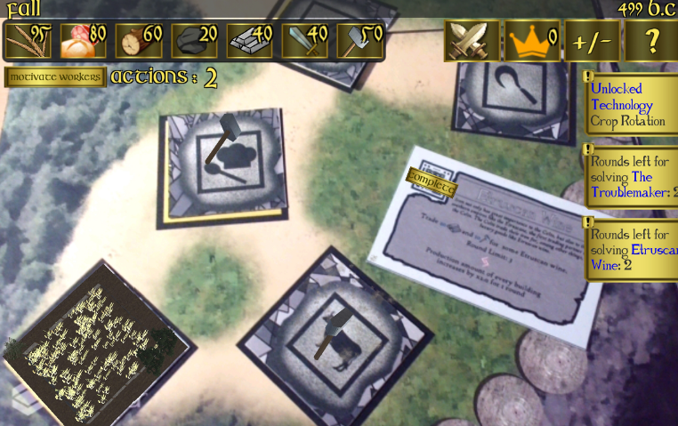
Introduction - Serious Games
Combination of Entertainment & Serious Content
Competition: Knowledge for the Victory!
Keeping Players busy
AR features

Slide 9
Problem Description: Issues
Missing Introduction System
Offline Multiplayer
Little Knowledge Transfer
Testing
Sparse Smartphone Integration

Slide 10
Related Work
Kanji Game [2]
  Learning Kanji Signs
  Serious Game
ChiKo [3]
  Serious Game
  Historical Background
  Mini Game
Capture Flag [4]
  AR
  Competitive Game

Slide 11
Approach
Tutorial
Online Multiplayer
Ogham Writing and Learning
Android Integration
Evaluation

Slide 12
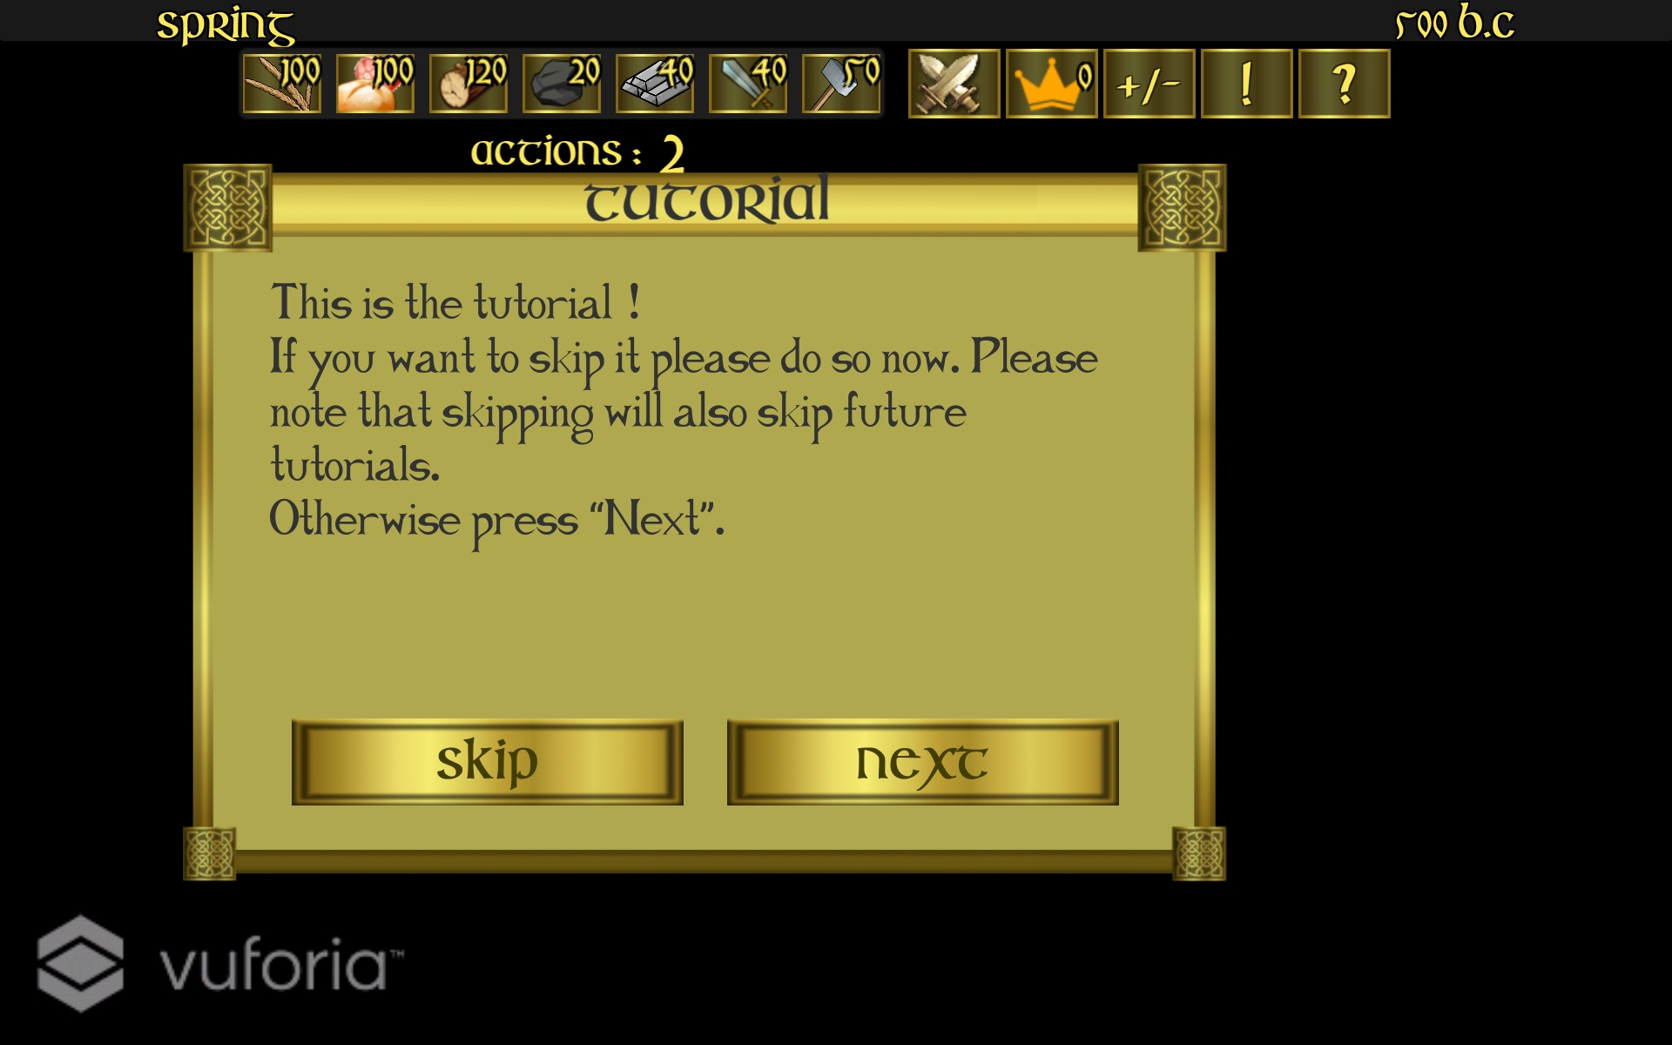
Implementation - Tutorial

Slide 13
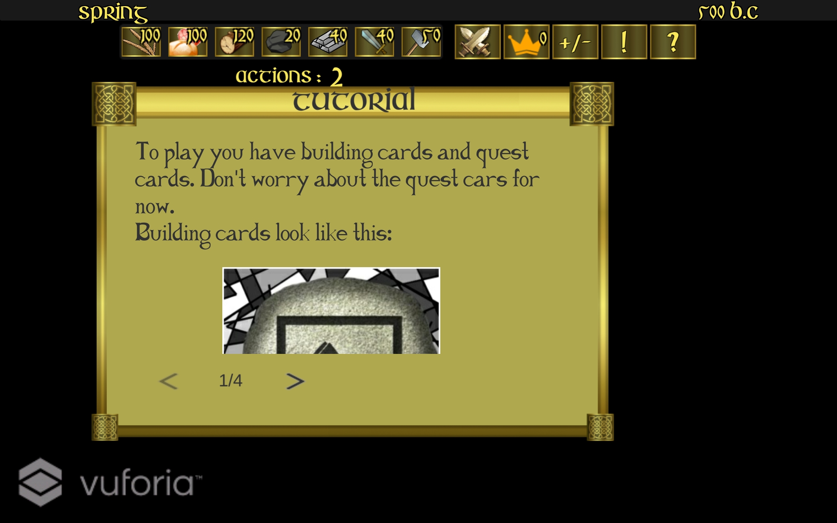
Implementation - Tutorial

Slide 14
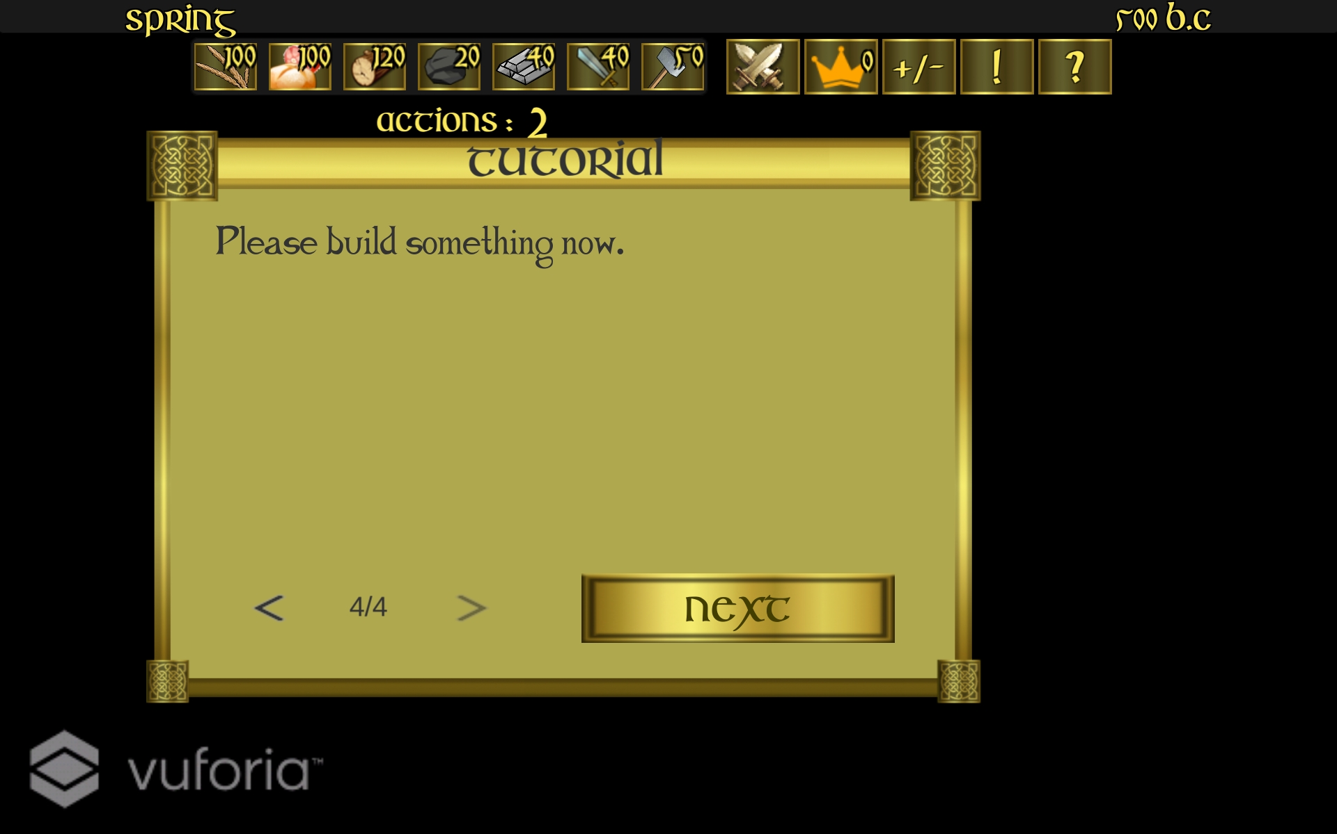
Implementation - Tutorial

Slide 15
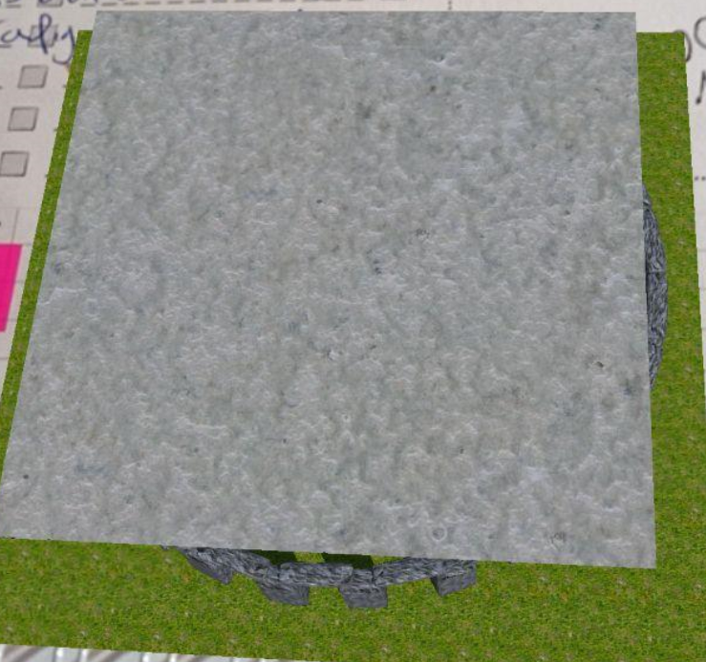
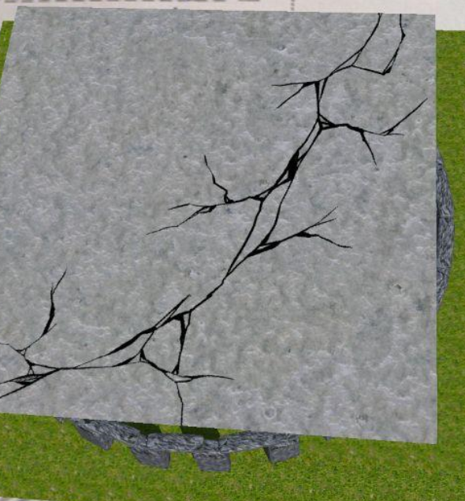
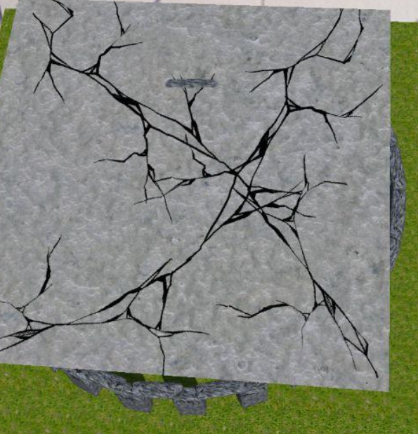
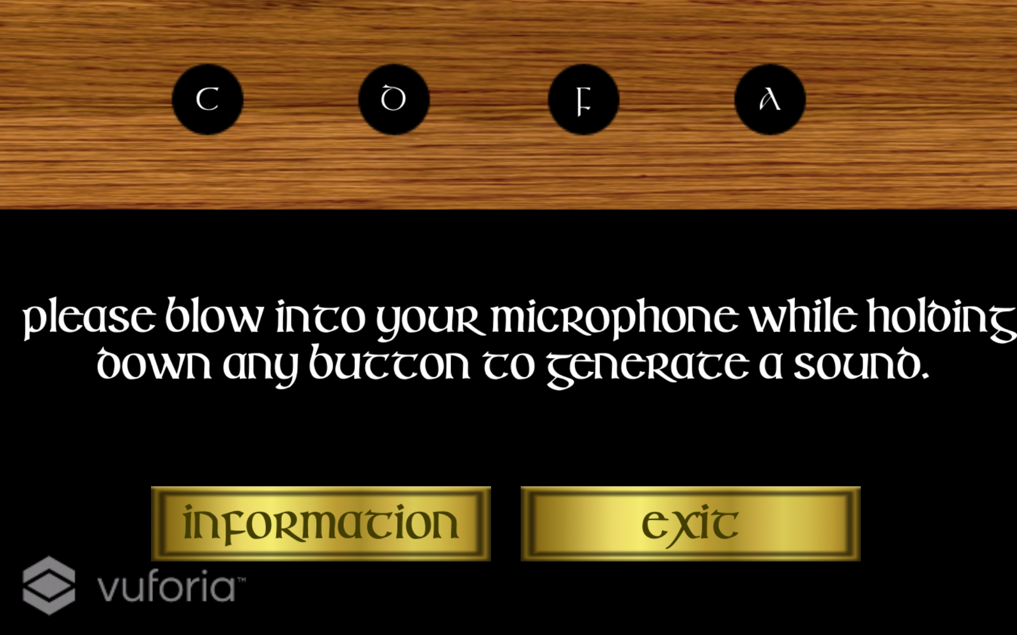
Implementation - Android Integration
Accelerometer
Microphone

Slide 16
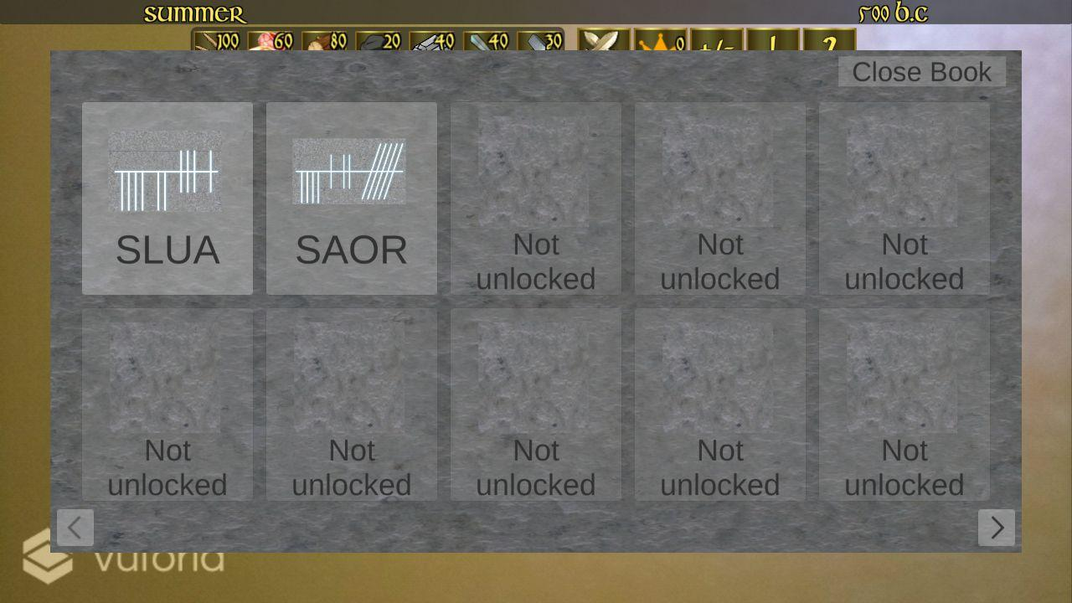
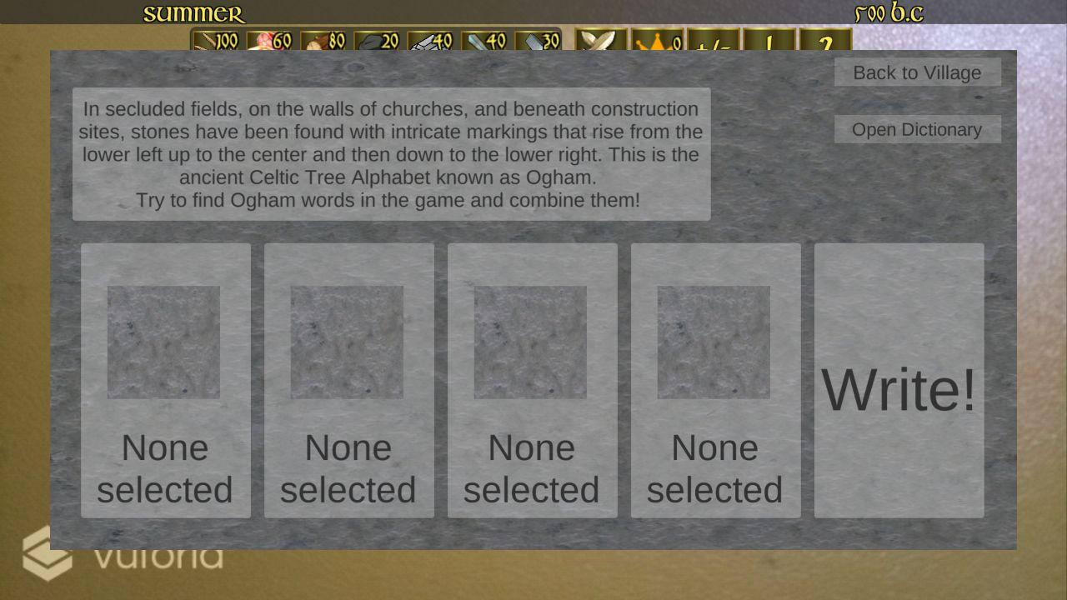
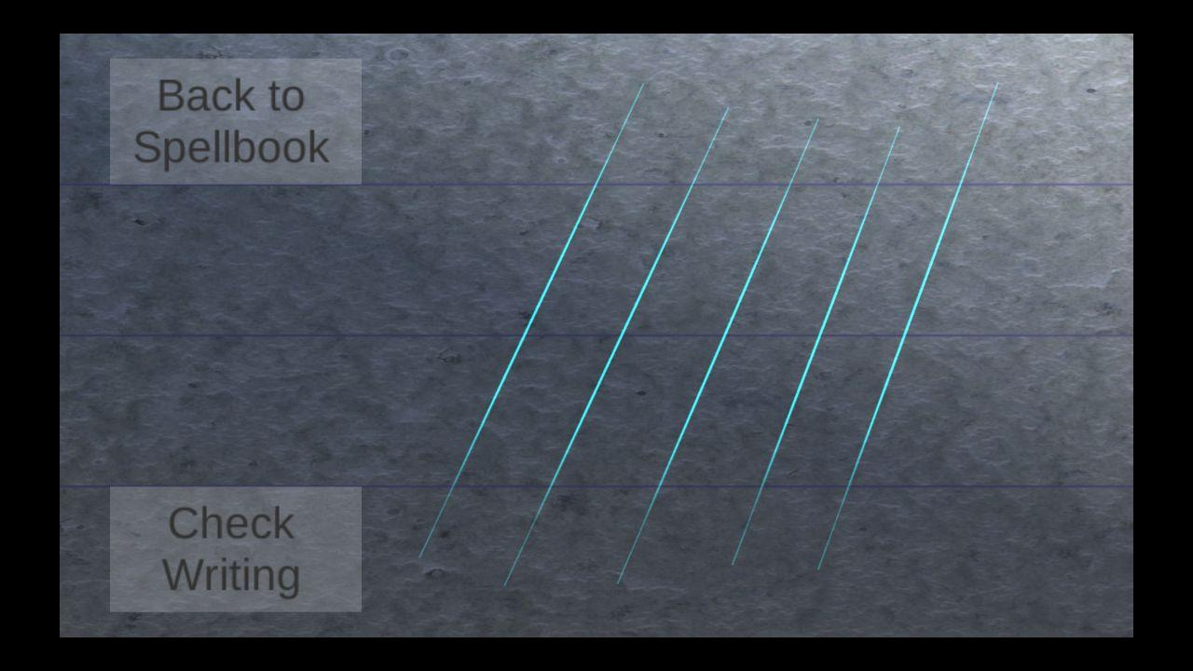
Implementation - Ogham System

Slide 17
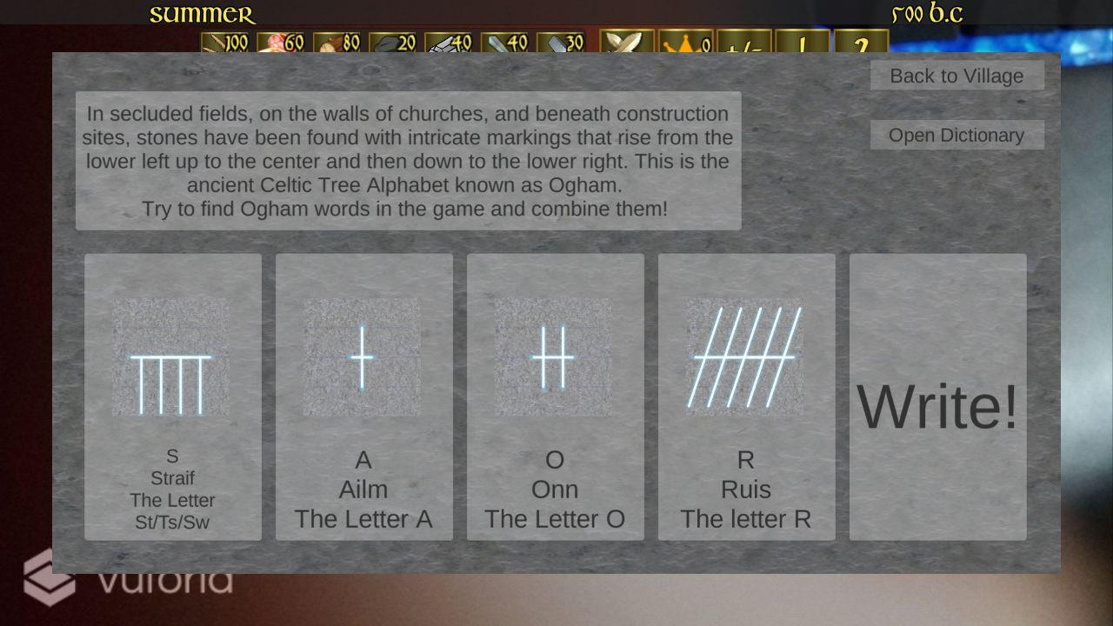
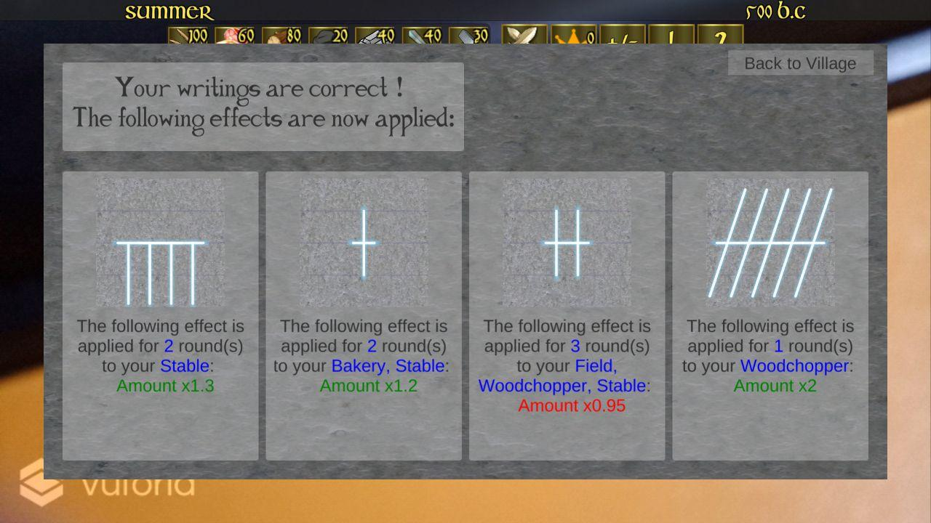
Implementation - Ogham System

Slide 18



Implementation - Multiplayer
AWS
Graphics: materialui.co and Google

Slide 19





Implementation - Testing Method
Report
Graphics: materialui.co and Google

Slide 20
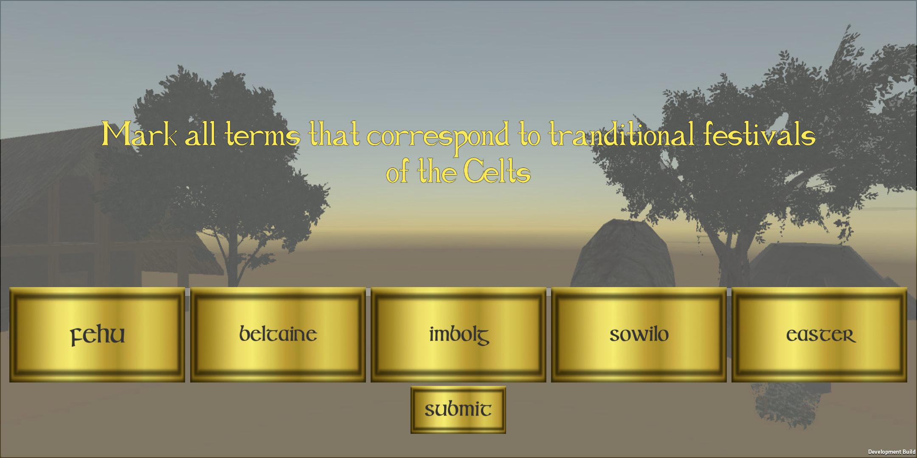
Evaluation Data
Questionnaire
  Taken from Master Thesis from Konstantin Gomm
Usage Data
  Actions
    Buildings Build
    Technologies Researched
    Skip
  Questcards
  Quizwar Questions

Slide 21
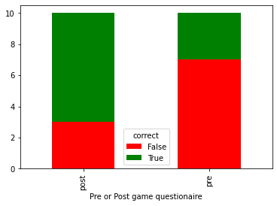
Evaluation

Slide 22
Discussion / Suggested Future Work
Greater Testing Range
  Competition vs Cooperation
  Digital or Physical Board
Entertainment:
  Minigames and Immerison
  Storyline and Motivation
Learning based Methods
  More!

Slide 23
Conclusion
Enhancement of Oppidum...
  as an Educational Game (Ogham & Additional Content)
  as a Fun Experience (Android) Integration
Supply of a Corona Proof Game...
  by Enabling Online Multiplaying
  by Introducing a Tutorial
BUT based on...
  Theoretical Background
  Not Extensive Testing

Slide 24
List of References
M. Mortara, C. E . Catalano, F. Bellotti, G. Fiucci, M. Houry-Panchetti, P. Petridis. “Learning cultural heritage by serious games” 2014.
K. Brandl, J. Kindl, S. Kreisig, M. Wintergeist
“Dragon Tale. A Kanji Game” 2016
F. Bellotti, E. Ferretti, and A. De Gloria.
“Discovering the european heritage through the chikho educational web game” 2005
S. Mueller, A. Dippon, and G. Klinker.
“Capture the flag: Engaging in a multi-device augmented reality game” 2015
D. Plecher, K. Gomm, C. Eichhorn, G. Klinger
“Impact of Single- and Multiplayer Mode in a Serious-AR-Game for Cultural Heritage of the Celts” 2020

