Slide 1
Augmented Reality in
Chemistry Education
Laura Xourgias
21.07.2022
Final: Bachelor Informatics
Supervisor(s): Prof. Gudrun Klinker, Ph.D.
collaboration with Melanie Ripsam for the chemical and educational input
Notes:
Hi everyone and welcome to my presentation. My name is Laura and I will talk about Augmented Reality in Chemistry Education.
First of all, I will not go into to much details about Augmented Reality itself, as there to many topics to be covered. I will have my focus on chemistry education and the approach I took, which is an AR smartphone app.
If there are any furthers questions about topics I did not cover, your very welcome to ask them afterwards.
So let's dive right into my presentation

Slide 2
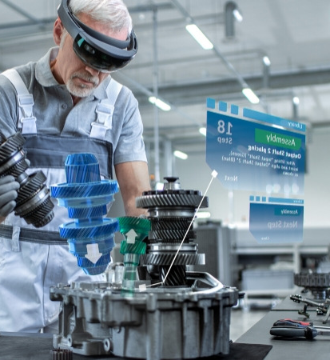
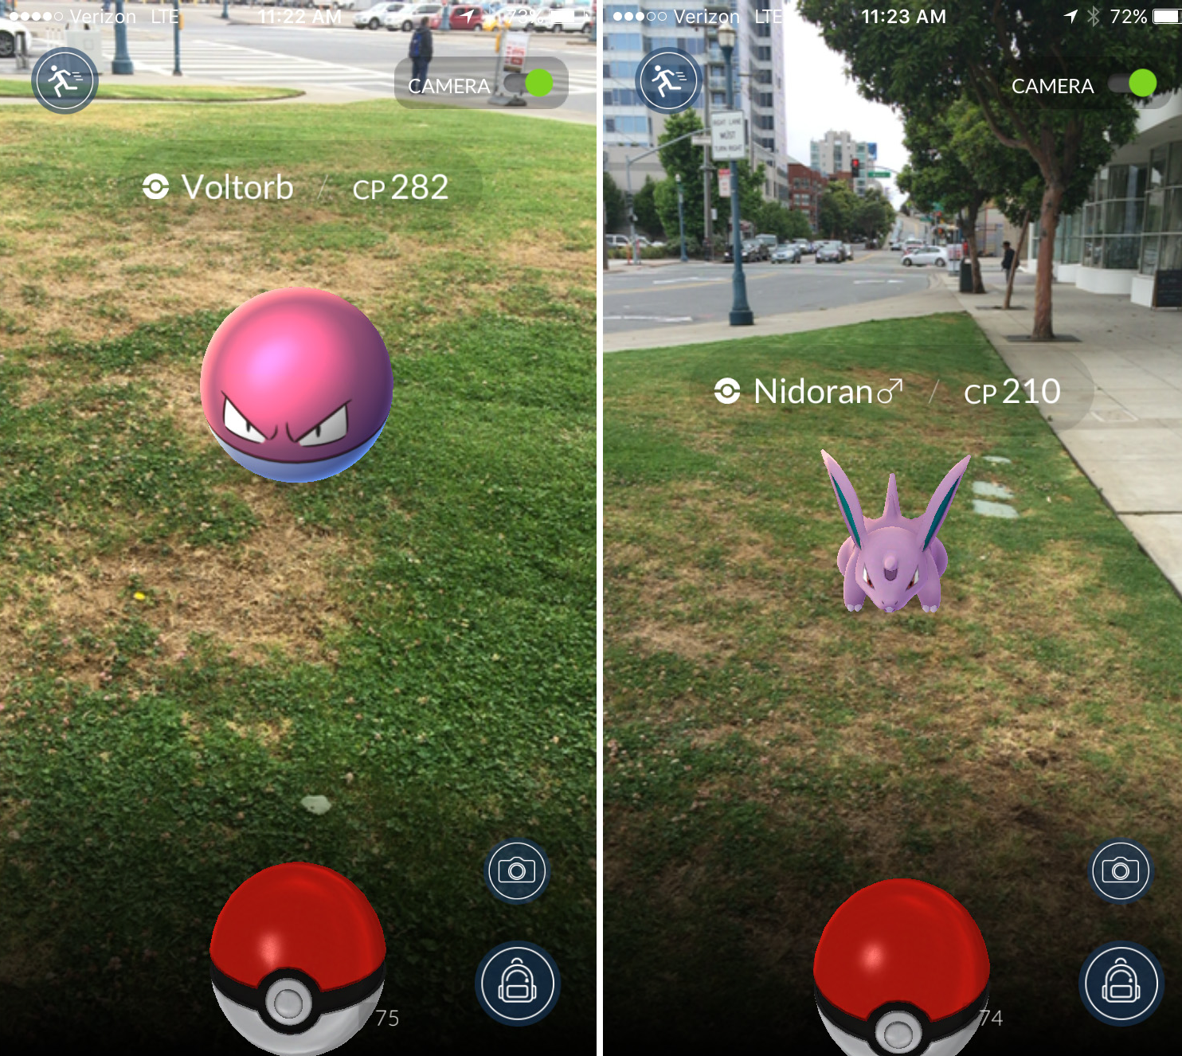
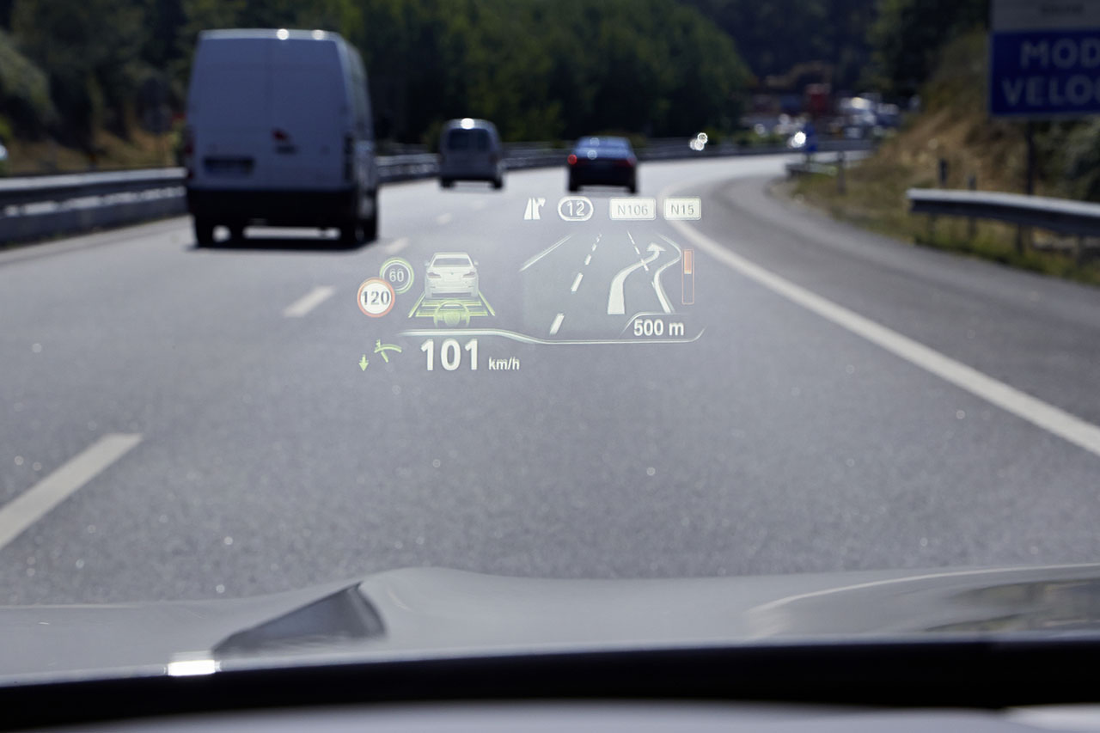
Augmented Reality
Notes:
AR is a growing technology, especially in recent years the areas of applications became more and more as the technology became cheaper and more avaible.
It is possible to display content from 2D paper as 3D models to create a better understanding, e.g. of the different steps to assemble an engine
On the other hand, AR is also used in HUDs in cars to bring information like the speed or the naviation into the direct field of view of the driver
But not only with special displays, but with a simple smartphone, AR can be used, as it is in the well known game Pokemon Go, e.g.
Combining these three big features of AR, which are bringing information into the direct field of view, bringing instructions from paper into 3D models and using all this which smartphone, it is well suited for using it in chemistry classes

Slide 3
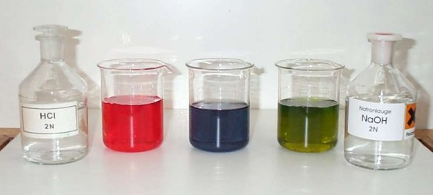
Why Chemistry?
Molecular level is hard to visualize
Only result is visual, but not reaction
Chemistry lessons have common thread
Neutral and acidic solution (Chemgaroo, 2022)
Notes:
- Chemistry is hard to visualize since it happens on a molecular level
- Students often only see the result, e.g. changing colors for changing pH values, but they don't see what happens
- results in lacking knowledge about chemistry
Buffer Reactions is a topic that combines a lot of knowledge: pH value, acid and base reactions, equilibrium reactions, transform formulas and calculate with them
Good topic to see where students may have lacking knowledge, as chemistry lessons have commong thread
Missing one topic makes everything a lot harder to understand
BUT: Missing visualization of what happens in buffers leads to lacking understanding of students about buffers
Leaving it out of class completely makes following topics even harder to understand

Slide 4

Research Question
How can AR be used as a tool in chemistry education to support the learning process of students?

Slide 5
Related Chemistry Applications
Desktop Applications:
Jmol
AR Smartphone Apps:
RAppChemistry
Form 5 Chemistry AR

Slide 6
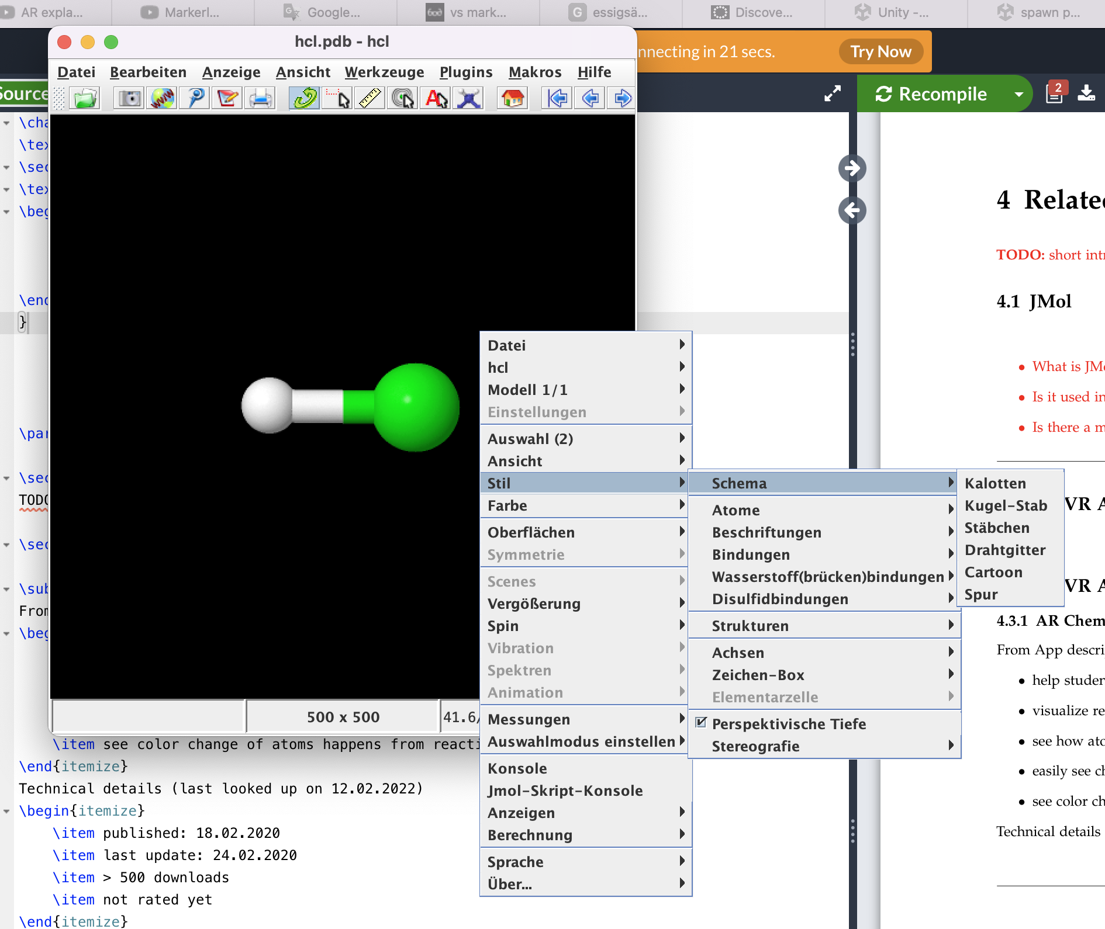
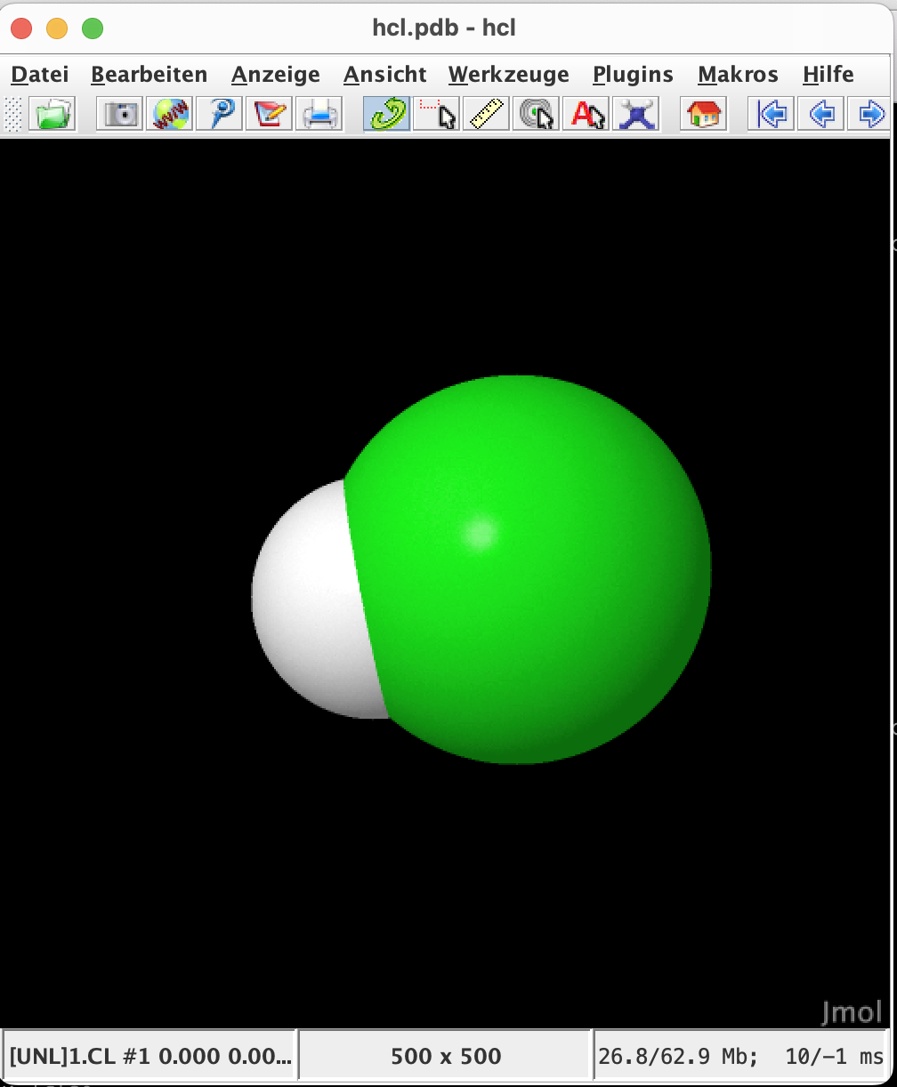

Jmol
Screenshots of $HCl$ in Jmol
Notes:
“Jmol is an open-source java viewer for chemical structures in 3D” that is how it is described on their webpage
Molecules can be displayed in different views, e.g. ball-and-stick model (represented on left) or CBK Spacefil model (represented on right)
interaction with molecule, to rotate and to zoom in and out, happens via mouse
It’s an established tool, because complex molecules are hard to visualize otherwise
However, in school, mostly only simple models are views, were molecular construction kit is sufficient
To shortly remember you: MCK on next slide

Slide 7
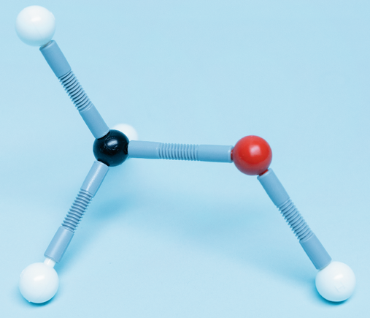
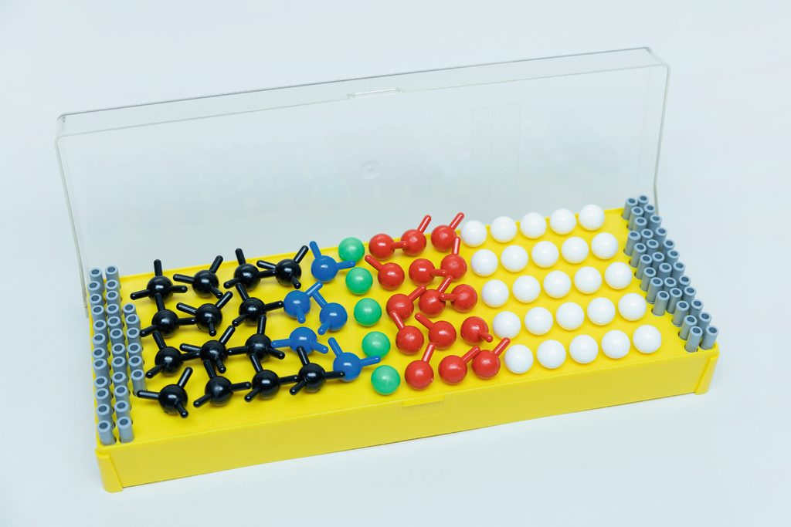
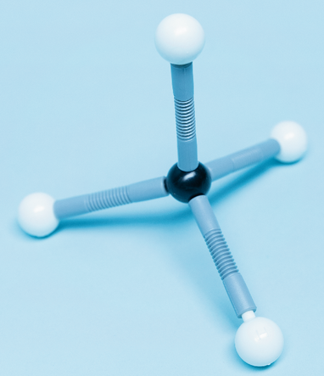


Molecular Construction Kits
$CH_{3}OH$model
Molecular construction kit “Molekülbaukasten 1” from Cornelsen (Cornelsen, 2022)
$CH_{4}$model
Notes:
Five different balls, representing atoms
Grey stick things represent bonds
Molecules can be assembled by sticking them together
Good to get high motivation to learn about molecules because it’s hands-on
BUT: they are static and no dynamic changes in molecules during reactions is possible
Only very limited in their possibilities, even though it is sufficient for most basic chemistry classes

Slide 8
Jmol
Screenshots of $HCl$ in Jmol
Notes:
Advantage of Jmol compared to MCKs:
More complex molecules are possible
Easily changing the model to look at different properties of the molecules
BUT:
Hands-on experience is important => therefore no replacement for MCK
The direct interaction with their on hands creates better understanding

Slide 9
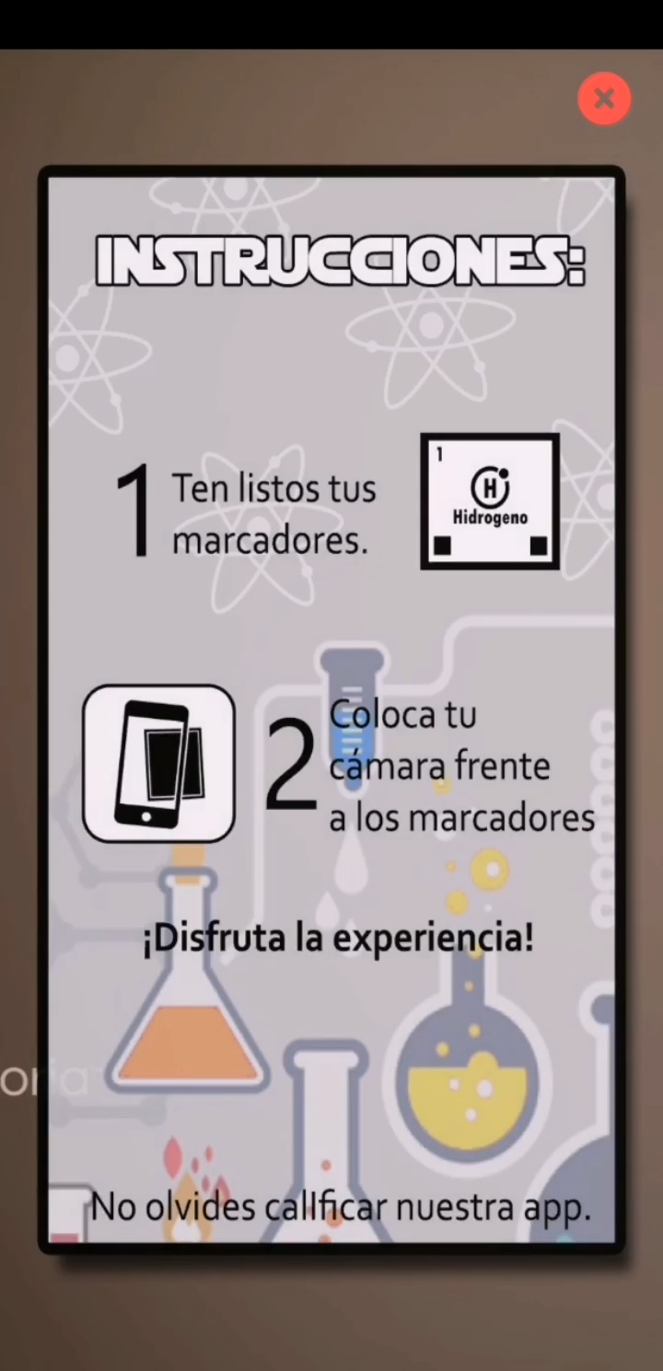
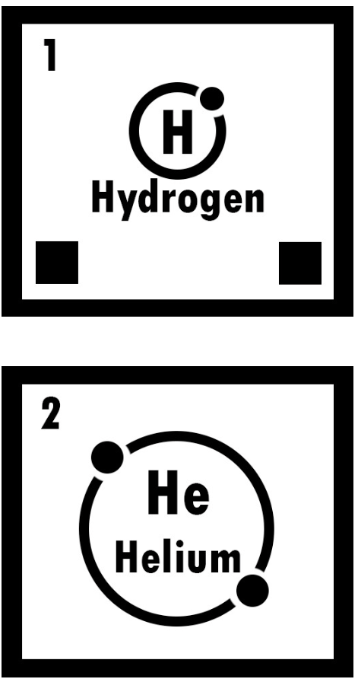
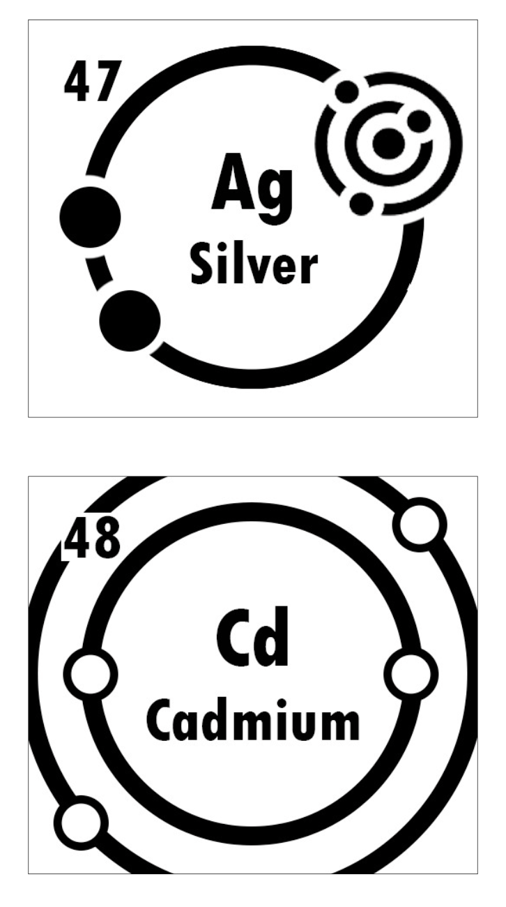
RAppChemistry
Screenshots of markers of RAppChemistry
Notes:
spanish app, but since it's rather self explanatory, no spanish skills are needed
In the app you can download a file with markers for all chemical elements
When holding the camera onto the markers, information about them are displayed, which looks like this
On these element cards, you have the symbol, the same, the electron configuration and the mass
Additionally, atom models are displayed, which are based on the Rutherford-Bohr-model
No interaction is possible

Slide 10
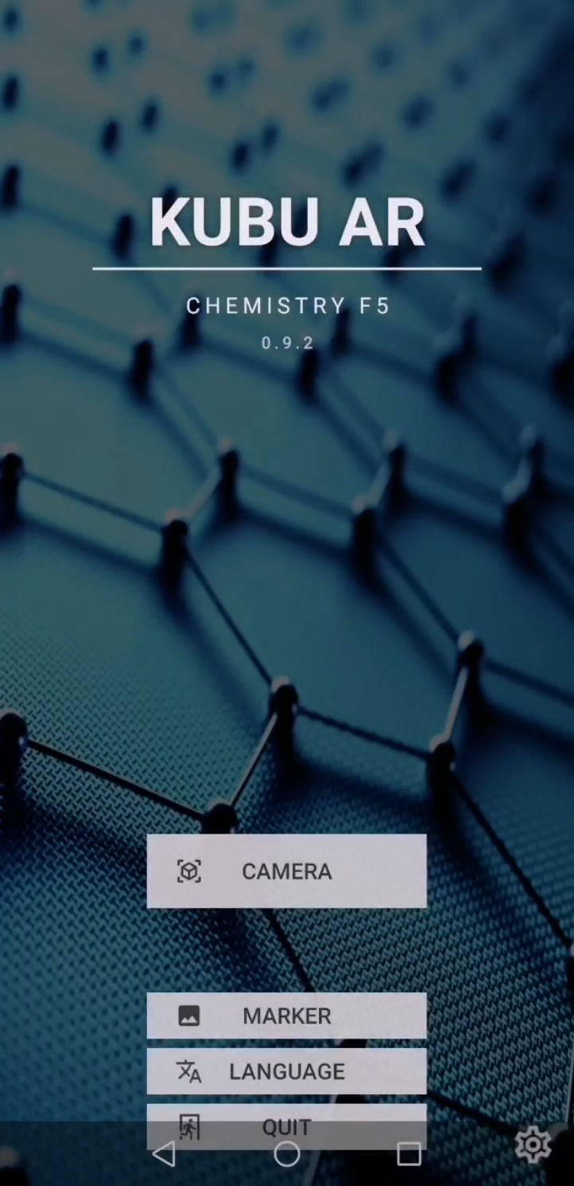
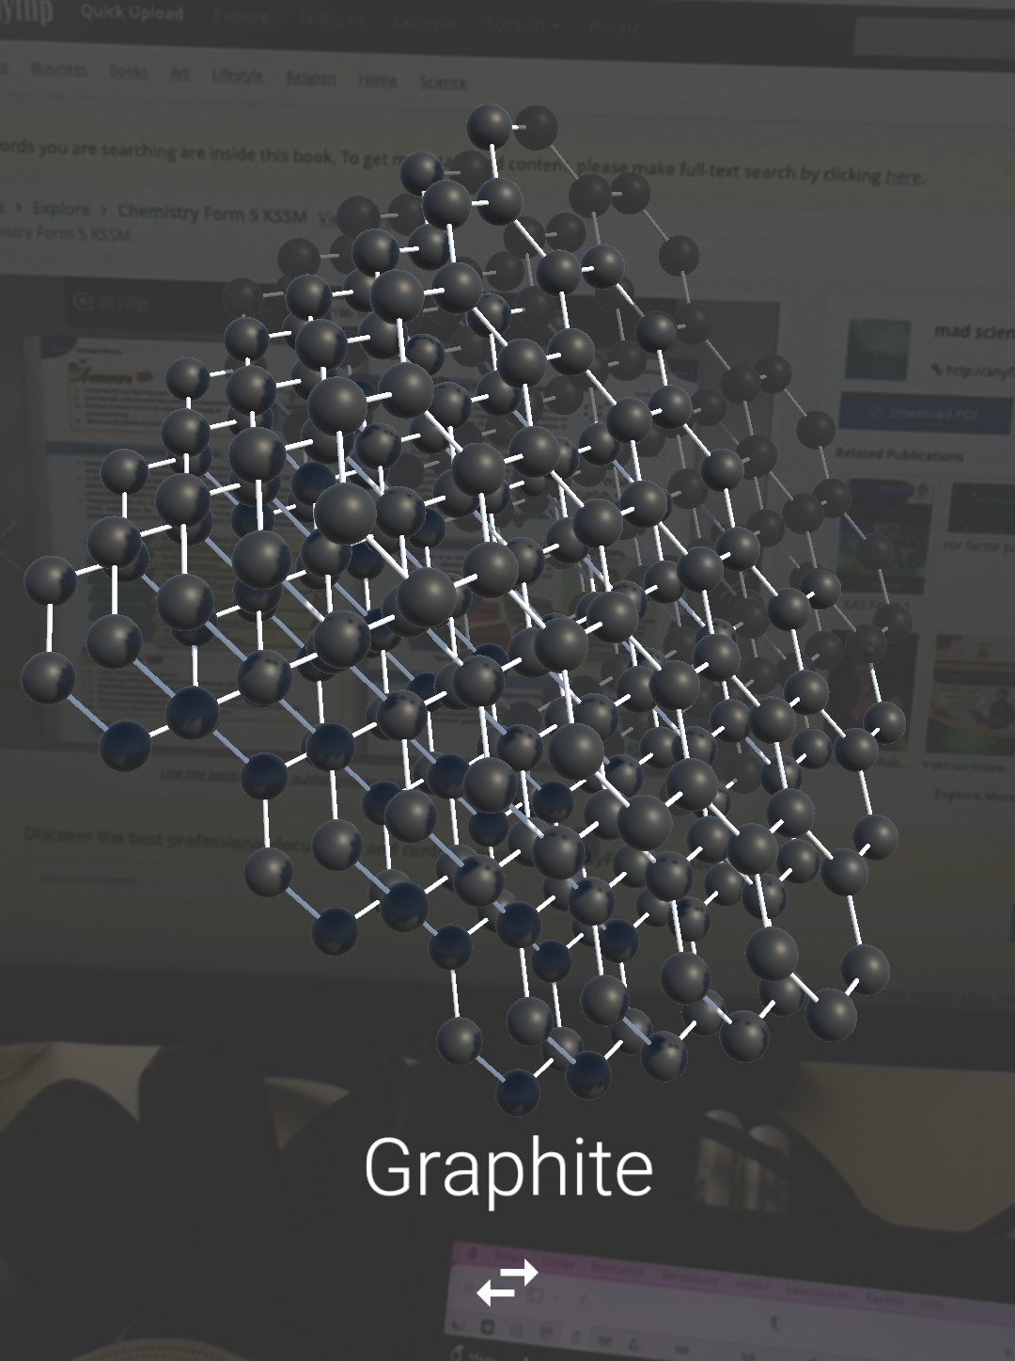
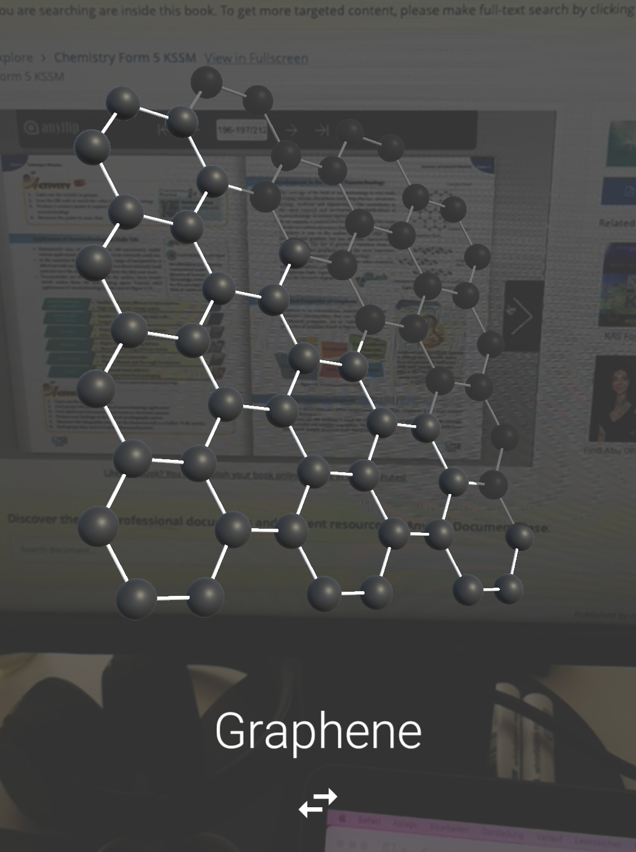
Form 5 Chemistry AR
Screenshots of augmentations of Form 5 Chemistry AR
Notes:
Form 5 Chemistry textbook augmentations
Only augmentations for 2 pages available
Molecules can be rotated via touch
No zoom function, but size of augmentation is dependent of size of textbook
Good idea, since easy and fast changing between to isomers can support understanding
Good basic idea, but would have to be done for all pages to have better ratio between costs and benefits
PROBLEM: text-book oriented approach leads to a lot of markers and augmentations needed
Not only between different school years, but different publishers, different countries and so on
=> topic oriented approach only needs one augmentation per topic and more flexible for teacher to fit into their class
After evaluating all these applications – and I even looked into a lot more – I created a mind map with the most important aspects I wanted to include into my own approach

Slide 11






Evaluation
Not only viewing static molecules
Visualize dynamic reactions
Integrate into class
Expandable subject area
Dynamic
Assistance at home
Different skill levels
Extensible
Accessible
Less frontal lessons
ARChem
Hands-on experience
Interactive
Intuitive handling
Learning in own speed
No additional knowledge
Notes:
Most important advantage of using AR in chemistry education is the possibility to visualize dynamic reactions
With other tools, e.g. molecular construction kits or even Jmol, only static view is possible
But using AR creates the possibility to not only create dynamic 3D models, but viewing them while looked at the real experiment and with that directly creating the connection between the visual result and the knowledge of what is happening on a molecular level
Therefore I wanted to start with augmenting an experiment and adding 3D models to include new perspectives and information, such as the molecules of the reaction taking place
When I thought about what experiment to augment, I wanted to make sure to not be restricted to this one experiment, but being extensible, other than it was done with RAppChemistry
address different skill levels so that both good and bad students are addressed
The result was not an AR app, but an AR learning environment
i.e. that there are not only augmentations, but also theoretical assistance and quizzes for verification
This concept of creating a learning environment also enables the possibility for students to learn at their own speed
As this presentation is rather limited in time and I see that I don’t have that much time left, I skip the rest of the points, but you are welcome to look at them afterwards and ask questions
So let’s go on and take a look at my app ARChem

Slide 12
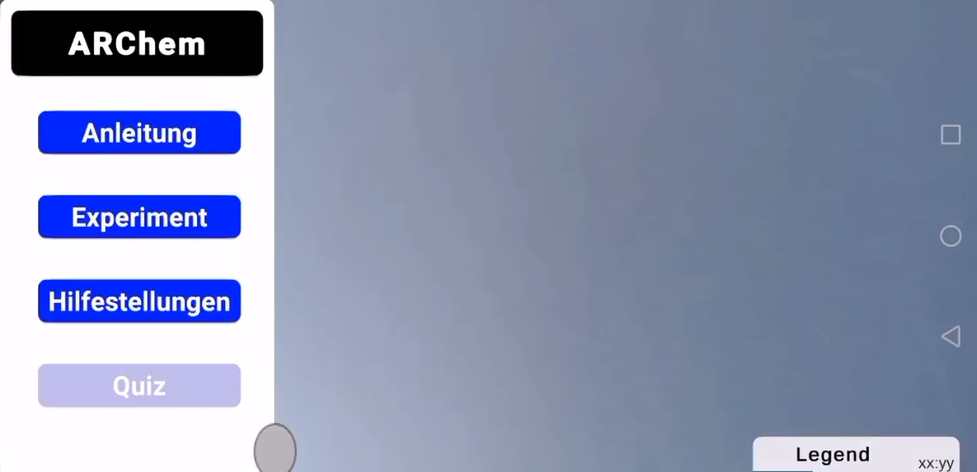
ARChem
Notes:
Here I have a demo video of my app
and the topic I ended up choosing for my app – to start off with - are buffer reactions
I chose this topic as it already is a rather advanced topic, which is not understood correctly by a lot of students, but it is not too advanced for being unimportant for the chemical education of students
Therefore you have a good balance between basic knowledge, which is needed to understand the subject, but also a lot further going topics, that can be added
So here we see, that there is a small instruction page in the app, where it is shortly explained, what the aim of the app is and some formal things like the sources of the theoretical texts included.
Next, we see that a marker is put in front of the camera to create the augmentation of a beaker, containing the molecules of a buffer – which actually is the acetic acid sodium acetate buffer.
Most of you probably will not remember any of these chemical contents, but that is rather unimportant for this presentation. But if you’re interested in learning more about buffers, I would be glad to give you access to my app.
So overall, there are several markers available, which all together create a basic experiment, used to teach buffer reactions. You always have this beaker, which is either augmented or if you have access to actual chemical equipment, like when the app is later used in class, the augmentations are added inside a real beaker. But since I’m in quarantine, I could not create this demo video using real beakers, as I didn’t have access to a chemical laboratory.
Beside the Augmentations there is also a small legend, with some additional information about the augmented molecules, so by clicking on the picture, you get access to some information.
But there are not only information about the molecules, but when clicking on the assistance button, you get to a text view, where you can read through some more theoretical knowledge. And there you see, what I just told you, you don’t only have some theoretical knowledge about the topic itself, but you also have some more basic knowledge. Unfortunately, these texts have not yet been fully worked out, I am still working on them at the moment. Together with a teacher, I am currently evaluating what knowledge is necessary and what theory should be included

Slide 13
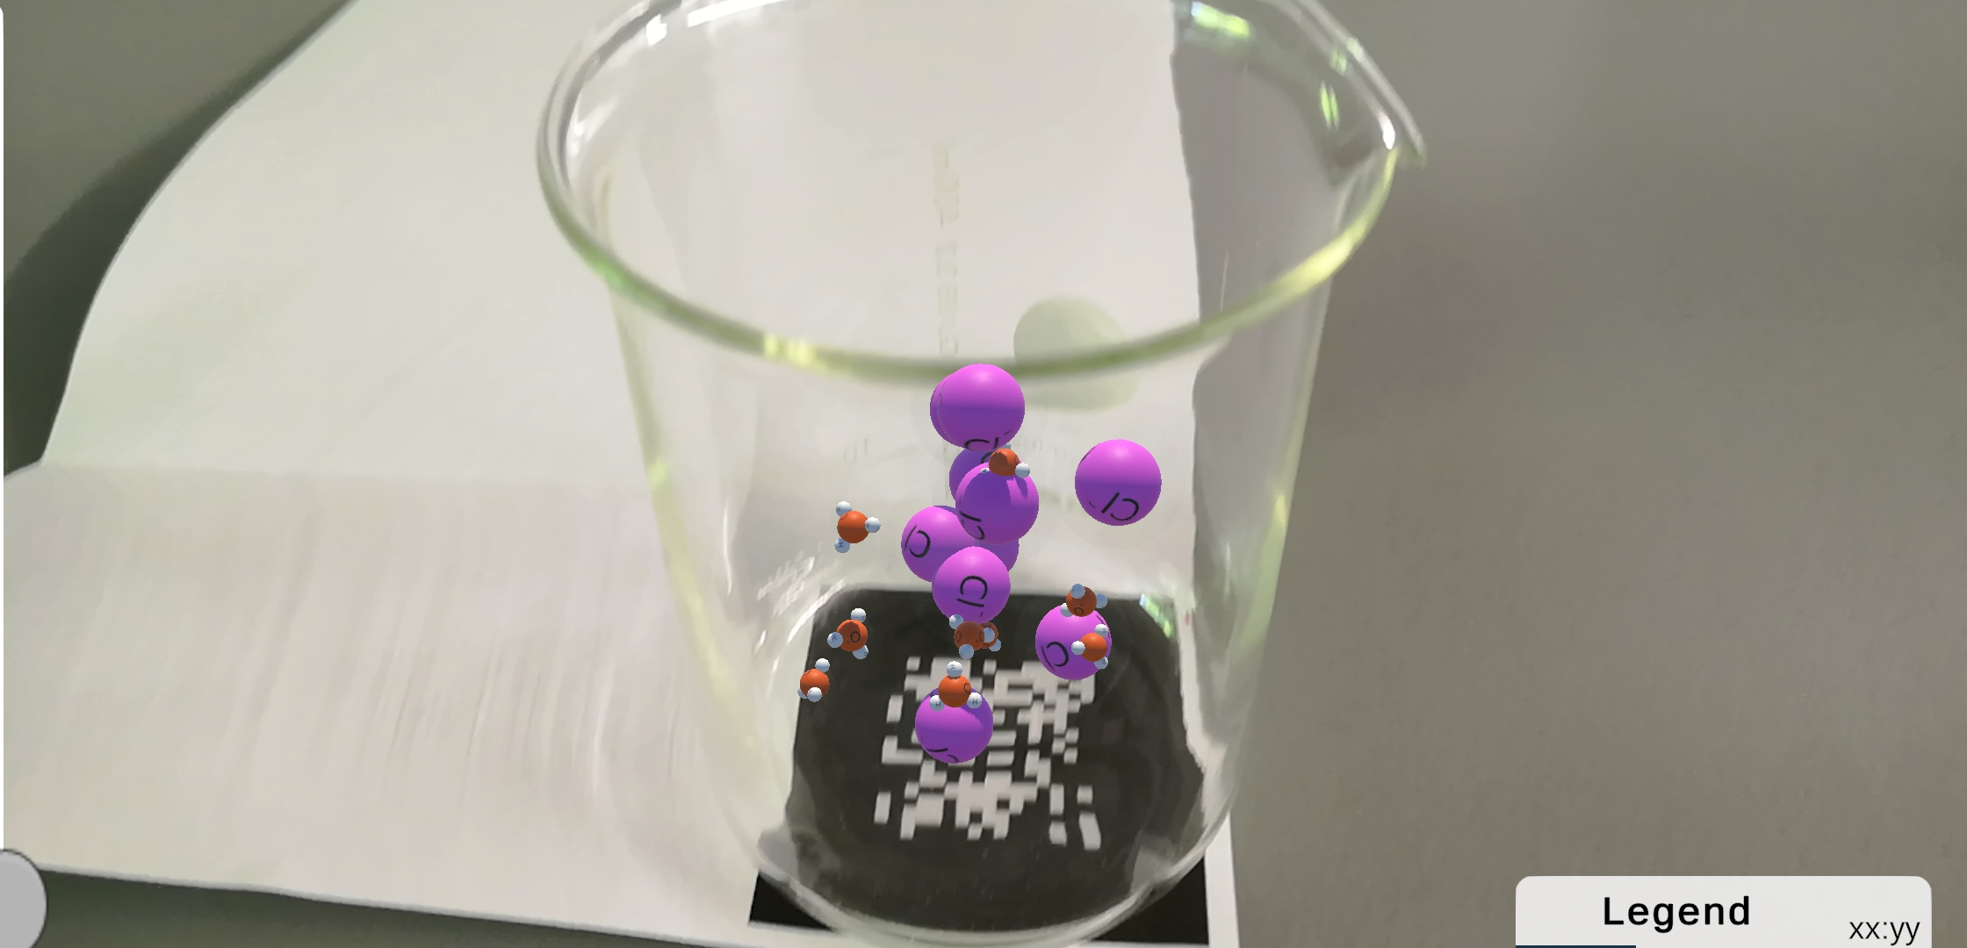
ARChem
Notes:
Here I have a demo video of my app
and the topic I ended up choosing for my app – to start off with - are buffer reactions
I chose this topic as it already is a rather advanced topic, which is not understood correctly by a lot of students, but it is not too advanced for being unimportant for the chemical education of students
Therefore you have a good balance between basic knowledge, which is needed to understand the subject, but also a lot further going topics, that can be added
So here we see, that there is a small instruction page in the app, where it is shortly explained, what the aim of the app is and some formal things like the sources of the theoretical texts included.
Next, we see that a marker is put in front of the camera to create the augmentation of a beaker, containing the molecules of a buffer – which actually is the acetic acid sodium acetate buffer.
Most of you probably will not remember any of these chemical contents, but that is rather unimportant for this presentation. But if you’re interested in learning more about buffers, I would be glad to give you access to my app.
So overall, there are several markers available, which all together create a basic experiment, used to teach buffer reactions. You always have this beaker, which is either augmented or if you have access to actual chemical equipment, like when the app is later used in class, the augmentations are added inside a real beaker. But since I’m in quarantine, I could not create this demo video using real beakers, as I didn’t have access to a chemical laboratory.
Beside the Augmentations there is also a small legend, with some additional information about the augmented molecules, so by clicking on the picture, you get access to some information.
But there are not only information about the molecules, but when clicking on the assistance button, you get to a text view, where you can read through some more theoretical knowledge. And there you see, what I just told you, you don’t only have some theoretical knowledge about the topic itself, but you also have some more basic knowledge. Unfortunately, these texts have not yet been fully worked out, I am still working on them at the moment. Together with a teacher, I am currently evaluating what knowledge is necessary and what theory should be included

Slide 14
Expert Interviews
7 expert interviews: 6 student teachers, 1 teacher
Digital media in classroom
  5 positive, 2 negative biases
Addressed problems:
  Minor issues -> are partly fixed
  More structure
Notes:
did not have the time to make a study
but talked to some chemistry student teachers
I asked them what their general opinion of the use of digital media in chemistry lessons is and 5 of them said that they like using digital media, which are not only apps, but also including videos into their class and so on
the other 2 actually said that they are not very tech-savy and they don't really like includidung digital media, especially because everything they learned and tested so far in their studies is not really good and doesn't have enoug benefits over the conventional methods
I don't want to talk about too many details about the interviews, but after the app, they all gave me quite a positive feedback and even though there were some problems addressed, they were all minor issues, where I already fixed most of them.
But the most interesting thing I got from the interviews is that even the 2 quite of negative voices said, that they liked my app and the concept and would use it in their classes
it combines theory and practical knowledge; it can be integrated in different ways and creates a big benefit especially with the topic chosen

Slide 15
Expert Interviews
7 expert interviews: 6 student teachers, 1 teacher
Digital media in classroom
  5 positive, 2 negative biases
Addressed problems:
  Minor issues -> are partly fixed
  More structure
All experts were convinced of ARChem and its concept
Notes:
did not have the time to make a study
but talked to some chemistry student teachers
I asked them what their general opinion of the use of digital media in chemistry lessons is and 5 of them said that they like using digital media, which are not only apps, but also including videos into their class and so on
the other 2 actually said that they are not very tech-savy and they don't really like includidung digital media, especially because everything they learned and tested so far in their studies is not really good and doesn't have enoug benefits over the conventional methods
I don't want to talk about too many details about the interviews, but after the app, they all gave me quite a positive feedback and even though there were some problems addressed, they were all minor issues, where I already fixed most of them.
But the most interesting thing I got from the interviews is that even the 2 quite of negative voices said, that they liked my app and the concept and would use it in their classes
it combines theory and practical knowledge; it can be integrated in different ways and creates a big benefit especially with the topic chosen

Slide 16
ARChem Extensions
Further buffer reactions and quiz questions
Advances quiz mode
More structure
(More) interactions
Molecular construction kit in AR
Planning experimental setups
Notes:
Further buffer reactions:
Carbonix acid/ hydrogen carbonate buffer
Phosphate buffer
Deepen knowledge and not just apply knowledge to one specific buffer
The more examples the deeper the knowledge and the less memorizing
Further quiz questions
Determine more questions
Expert is needed
Interactions:
Trigger acid/ base addition
Was planned in app, but due to time issues and some small implementation errors
Should be done before study
Advances quiz mode:
Motivate students to reach 100%
Teacher could ask students to take quiz at the end or beginning of lesson to get overview of current level of knowledge
Teacher can keep track of learning curve and problems can be directly targeted
More flexibility for teacher to fit their lesson
More structure:
More information for respective augmentations
Explain in more detail what is happening in augmentation/ experiment
Allow students to use app in fullest extent at home and not only in class
Allows group work during classes and teacher only needs to supervise
Encourage independence
Less frontal teaching
More interactions:
Zooming in and out via touch creates better AR experience
Trigger acid/ base addition via marker o.ä.
Molecular construction kit in AR:
Start with simpler variants and expand them further and further
Choose from small number of molecules
More atoms than in ‘real’ MCKs
AR is dynamic, representing more realistic bonding angles etc.
Build molecules in other models than ball-stick-model
Convert built model between different views similar to Jmol
Planning experimental setups:
Plan experiments that cannot be performed in class
Plan experiments before perming them in class
Give better understanding about material than on chemix.org as they are 3D and real sized
Display additional information about used material, e.g. about different indicators

Slide 17
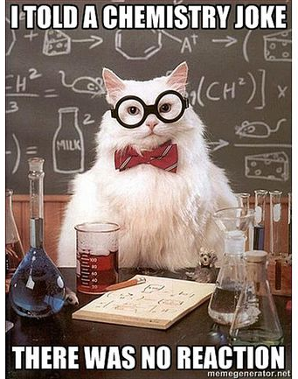
Thank you for listening!
Any Questions?
(Anne Marie Helmenstine, 2019)

Slide 18
ARChem
Notes:
Here I have a demo video of my app
and the topic I ended up choosing for my app – to start off with - are buffer reactions
I chose this topic as it already is a rather advanced topic, which is not understood correctly by a lot of students, but it is not too advanced for being unimportant for the chemical education of students
Therefore you have a good balance between basic knowledge, which is needed to understand the subject, but also a lot further going topics, that can be added
So here we see, that there is a small instruction page in the app, where it is shortly explained, what the aim of the app is and some formal things like the sources of the theoretical texts included.
Next, we see that a marker is put in front of the camera to create the augmentation of a beaker, containing the molecules of a buffer – which actually is the acetic acid sodium acetate buffer.
Most of you probably will not remember any of these chemical contents, but that is rather unimportant for this presentation. But if you’re interested in learning more about buffers, I would be glad to give you access to my app.
So overall, there are several markers available, which all together create a basic experiment, used to teach buffer reactions. You always have this beaker, which is either augmented or if you have access to actual chemical equipment, like when the app is later used in class, the augmentations are added inside a real beaker. But since I’m in quarantine, I could not create this demo video using real beakers, as I didn’t have access to a chemical laboratory.
Beside the Augmentations there is also a small legend, with some additional information about the augmented molecules, so by clicking on the picture, you get access to some information.
But there are not only information about the molecules, but when clicking on the assistance button, you get to a text view, where you can read through some more theoretical knowledge. And there you see, what I just told you, you don’t only have some theoretical knowledge about the topic itself, but you also have some more basic knowledge. Unfortunately, these texts have not yet been fully worked out, I am still working on them at the moment. Together with a teacher, I am currently evaluating what knowledge is necessary and what theory should be included

Slide 19
List of References
Anne Marie Helmenstine, P. D. (24. 01 2019). Chemistry Cat. https://www.thoughtco.com/chemistry-cat-meme-4054181?utm_source=pinterest_ip&utm_medium=sm&utm_campaign=shareurlbuttons (last accessed: 20.07.2022)
Chemgaroo. Chemie für Mediziner: Säuren und Basen. http://www.chemgapedia.de/vsengine/tra/vsc/de/ch/4/cm/chemmed.tra/Vlu/vsc/de/ch/4/cm/saeuren.vlu/Page/vsc/de/ch/4/cm/saeuren/eigenschaften.vscml.html (last accessed: 17.07.2022)
Cornelsen. Molekülbaukasten 1. https://cornelsen-experimenta.de/shop/de/Sekundarstufe/Chemie/Molekülmodelle%20und%20Periodensystem/18474-Molekülbaukasten+1.html (last accessed: 17.07.2022)
Csikszentmihalyi, M. (1990). Flow:The Psychology of Optimal Experience.
gamewheel. (12.07.2016). Trending News about Augmented Reality Games -Pokémon Go. https://www.gamewheel.com/pokemon-go-ar-game/ (last accessed: 17.07.2022)
Gourley, L. (05.11.2020). Harness the Power of Augmented Reality Glasses. Retrieved from https://www.ptc.com/en/blogs/ar/the-power-of-augmented-reality-glasses (last accessed: 17.07.2022)
Notes:
Images:
https://www.ptc.com/en/blogs/ar/the-power-of-augmented-reality-glasses
https://www.gamewheel.com/pokemon-go-ar-game/
https://next.reality.news/news/augmented-reality-cars-companies-tech-driving-us-into-future-0182485/

Slide 20
List of References
Jmol. (18.07.2022). Jmol: an open-source Java viewer for chemical structures in 3D. Retrieved from http://jmol.sourceforge.net (last accessed: 17.07.2022)
Bridger, G. (19.02.2016). BMW’s Latest Head Up Display https://www.bimmerfile.com/2016/02/19/bmws-latest-heads-up-display/ (last accessed: 20.07.2022)
Notes:
Images:
https://www.ptc.com/en/blogs/ar/the-power-of-augmented-reality-glasses
https://www.gamewheel.com/pokemon-go-ar-game/
https://next.reality.news/news/augmented-reality-cars-companies-tech-driving-us-into-future-0182485/

