Slide 1
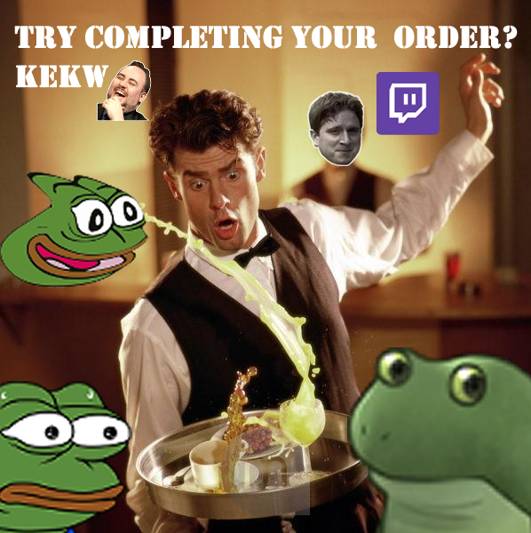
Chaos to Go
by Zwiebel auf dem Kopf
Dorota
Georg
Raoul
James

Slide 2

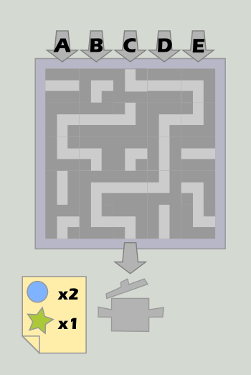
Concept Recap

Slide 3
Which features are done?
Gameboard with Conveyor-Belt-Tiles
Moving Ingredients over the Board
Tile Selection Bar
Cooking Pots for finishing food orders
Basic Score
Twitch-Interconnection with Poll System (Time to vote!)
Cel-Shader for In-game-models
Debugging-Console

Slide 4
Issues & Revisions
Usage of OpenGL3 for Visual Effects (Cel-Shader)
  Issues with black viewports for non-compatible environments
Ingredient Travel: What happens to ingredients on board in some cases?
  Replacing tiles with objects on them?
  Colliding Ingredients?
  Which tiles are really used by the player?
Minor issues with UI resolutions

Slide 5
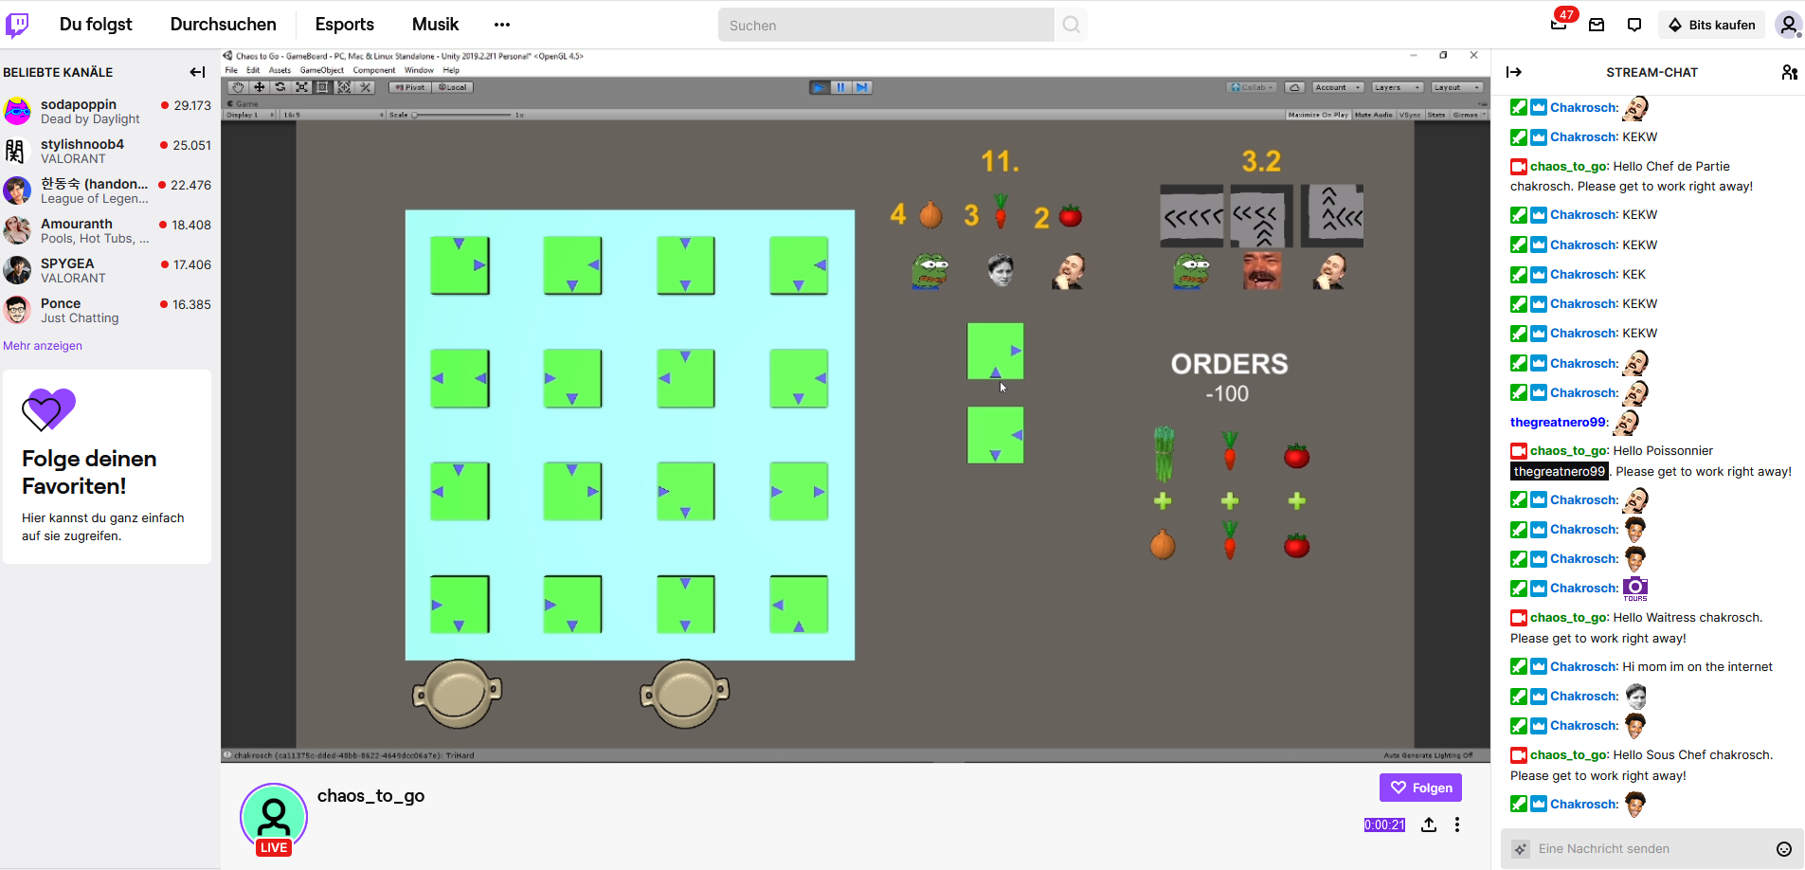
Testing with Twitch

Slide 6
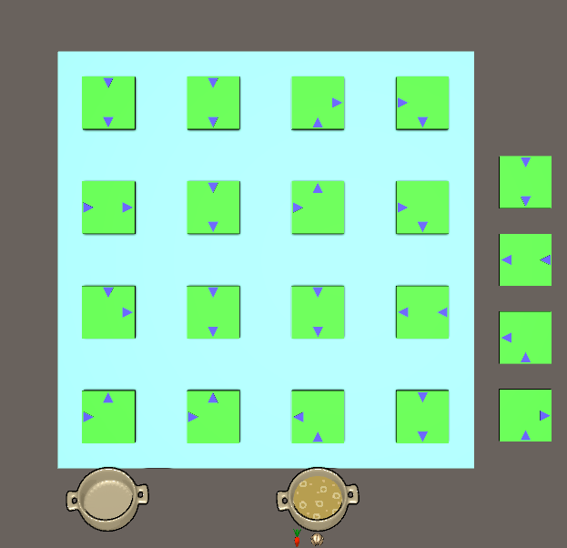
What’s next?
More models (For conveyer-belts, room scene, etc.)
3 - 5 Special Tiles
A larger board (4 x 4 -> n x m)
Improving the general travel behavior of ingredients on tiles
Sound & Music
Bug fixing…

Slide 7
Demo Time!

